Slide 1
Early Exploration and Colonization

Slide 2
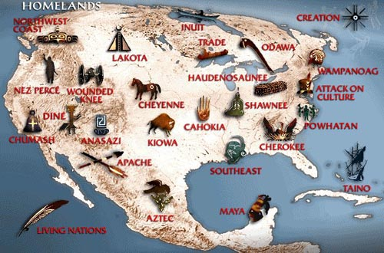
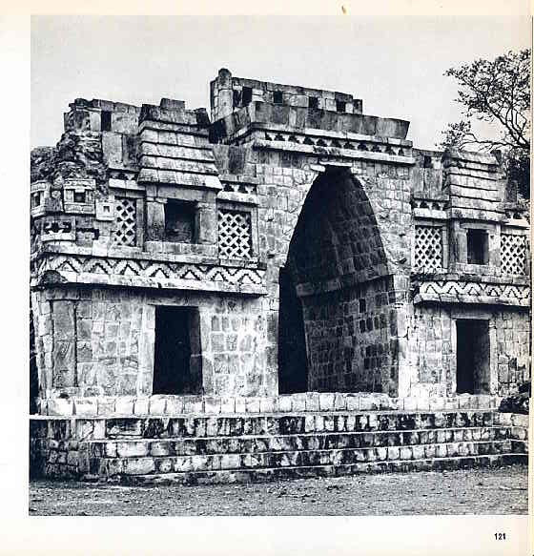
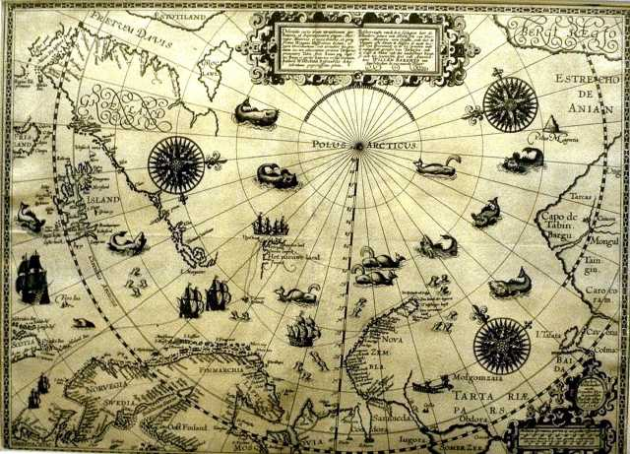
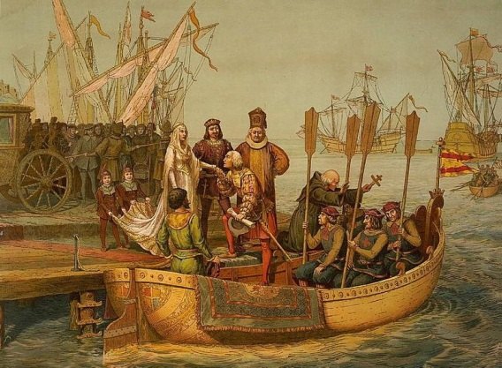
Where we start…
Mayan and Aztec societies flourishing
Millions of Native Americans living in the Americas
Europe was coming out of the Medieval or Dark Ages
With the beginning of Renaissance ideas, people began to think outside of Europe
With increases in technology, longer sea travel was possible

Slide 3
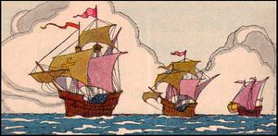
Then came 1492…
We all know what happened.
Today we will look at this one event to discuss how we learn about history

Slide 4
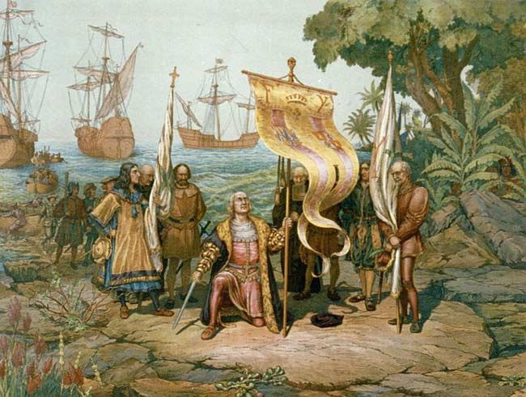
Image 1

Slide 5
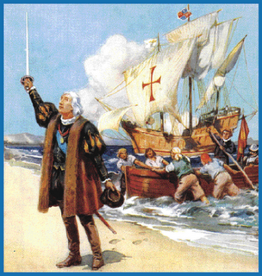
Image 2

Slide 6
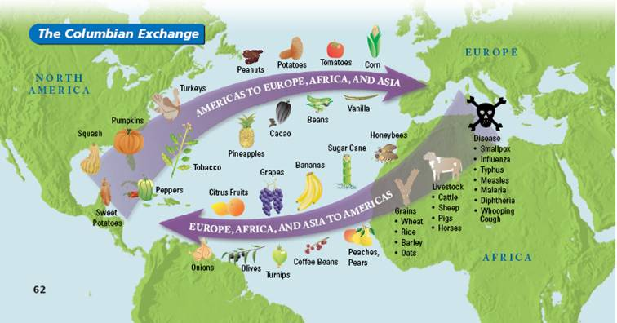
Image 3

Slide 7
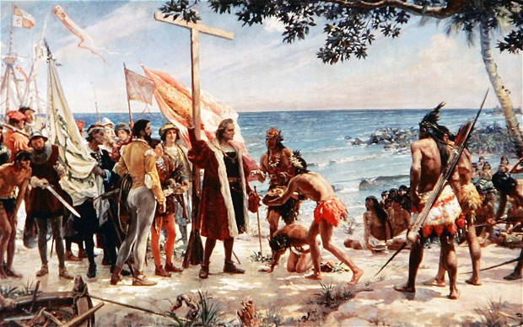
Image 4

Slide 8
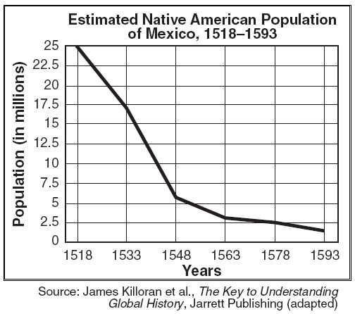
Image 5

Slide 9
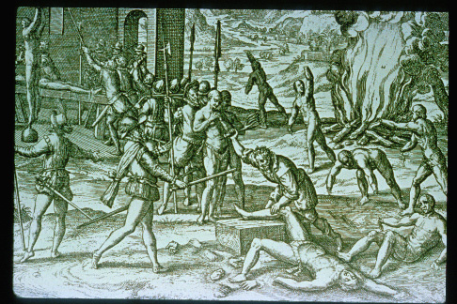
Image 6

Slide 10
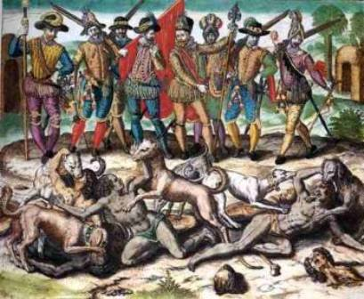
Image 7

Slide 11
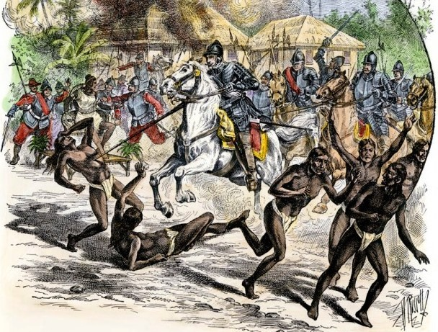
Image 8

Slide 12
Doc 1
Columbus Day—the day we celebrate Christopher Columbus’s historic discovery of the Americas in 1492—is a most unusual American holiday, as it commemorates an event that occurred well before the United States was a nation. And yet, in the 500 years since Columbus’s sighting, the day has become distinctly American. In the late 18th century, Americans began to see Columbus as somewhat of a mythic founding figure; by the 1830s, he was seen as an archetype of the American ideal: bold, adventurous, innovative. Immigrants in the 19th and 20th centuries rallied around the immigrant Columbus. As Ronald Reagan remarked in a 1988 speech, Columbus Day has become a day “to celebrate not only an courageous searcher but the dreams and opportunities that brought so many here after him.”

Slide 13
Doc 2
From one scholar’s writings on Columbus:
While reading Columbus’s log, I was struck by how many times Columbus ordered his men to not steal from the natives. Columbus made sure the Spaniards would be on their best behavior for those initial encounters. The natives freely gave all they had, or would trade objects of immense value for baubles. Columbus continually expressed his amazement that the natives traded all manner of goods to the Spaniards for trinkets, or simply gave them away. As the boats sailed from island to island, the most common native reaction was fleeing when the Spaniards showed up (some seem to have thought that the ships were sea monsters, while others timidly fled from the strange men and boats). The other reaction was warmly welcoming the Spaniards. Columbus and his men never received a hostile reception on that voyage.
Columbus regularly remarked on the astounding beauty of the islands and the natives’ friendly, happy, peaceful nature, but the obsession of his writings was always where the gold was and how the islands’ wealth could be exploited.

Slide 14
Doc 3
Within four years of Columbus' arrival on Hispaniola, his men had killed or exported one-third of the original Indian population of 300,000. Within another 50 years, the Taino people had been made extinct the first casualties of the holocaust of American Indians.

Slide 15
Doc 4
“It appears to me, that the people are ingenious, and would be good servants and I am of opinion that they would very readily become Christians, as they appear to have no religion. They very quickly learn such words as are spoken to them. If it please our Lord, I intend at my return to carry home six of them to your Highnesses, that they may learn our language. I saw no beasts in the island, nor any sort of animals except parrots.” – Christopher Columbus in a letter to King Ferdinand of Spain

Slide 16
Doc 5
Indians to sentence Columbus for genocide
REUTERS
TEGUCIGALPA, OCT 12: Honduran Indians will sentence Christopher Columbus for crimes against Indigenous Americans today, 506 years after his "discovery" of the continent. The Indians began a mock trial of Columbus in July on charges of genocide and robbery resulting from the 1492 beginnings of the colonisation of the Americas. Sentencing will take place today, which is Columbus Day, said Salvador Zuniga, director of the Council of Popular Organisations and Indigenous People. Many Indians throughout the Americas consider the arrival of Columbus as the start of five centuries of oppression. About 1,000 Indians blocked access to Mayan ruins and other tourist sites yesterday as part of a protest leading up to Columbus Day, authorities said. Last year Honduran Indians had destroyed a Columbus statue.

Slide 17
Let’s Review
https://www.youtube.com/watch?v=wsMGICONtb8
Take notes using note taking skills as we watch the video
Focus on finding examples of Positive and Negative Effects

Slide 18
Closing thought
Perhaps somewhere between the false dichotomies of Columbus as either hero or villain, the real Christopher Columbus—human, adventurous, imperfect—can be found. As the historian Felipe Fernández-Armesto notes, the answer to whether Columbus was saint or criminal “is that he was neither but has become both. The real Columbus was a mixture of virtues and vices like the rest of us, not conspicuously good or just, but generally well-intentioned, who grappled creditably with intractable problems.”

Slide 19
Early Settlers of the Americas
Over the next hundred years many people made a play for the vast resources of the Americas
Some famous ones you learned about before; such as Cortez and Pizarro and their conquest of the Aztecs and Incas
But many more followed not only to conquest but also to settle and create colonies

Slide 20
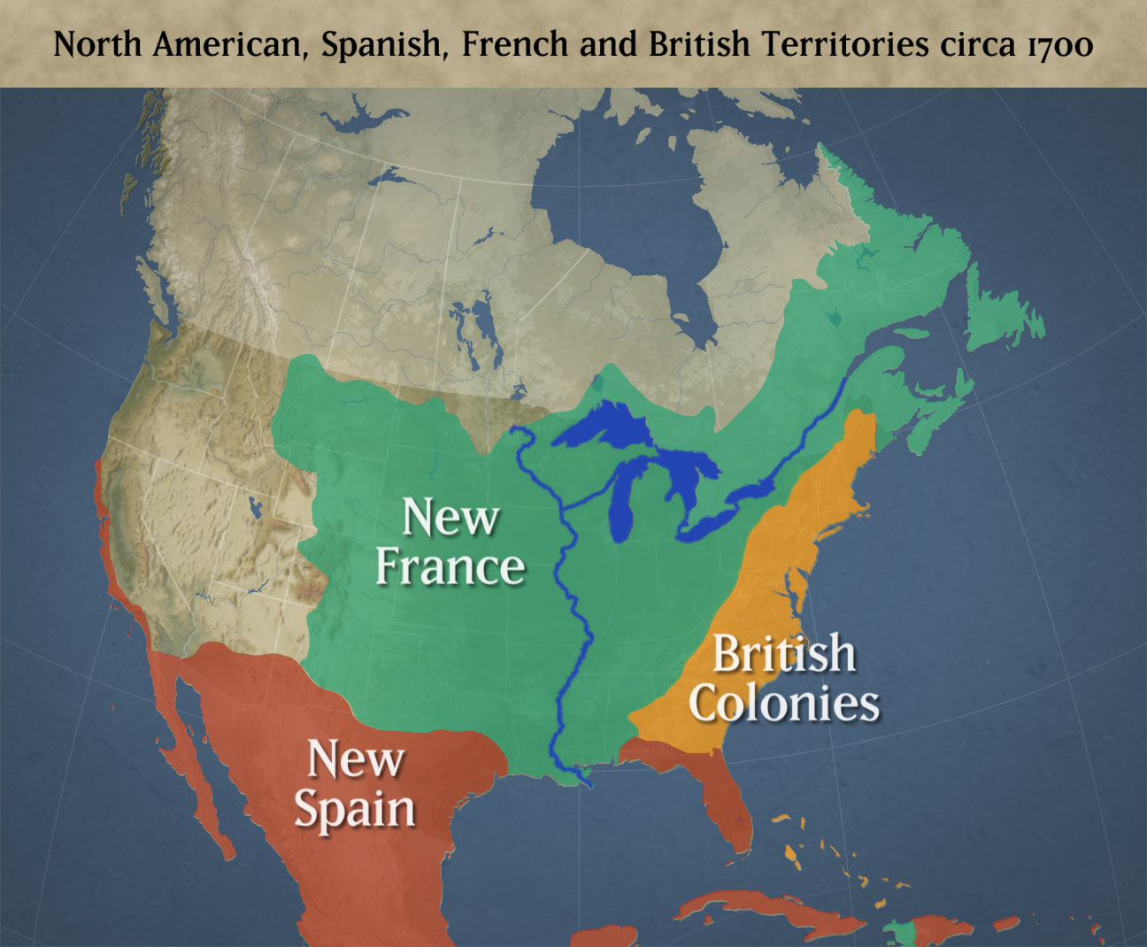
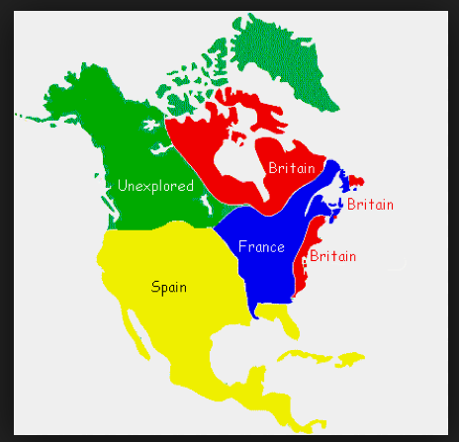
The three main groups to colonize America were:
France, Britain, and Spain

Slide 21
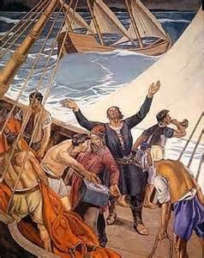
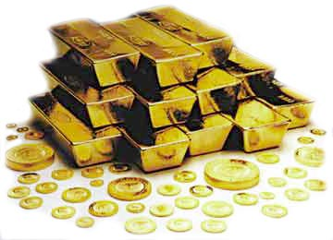
Reasons for Colonization
God- Explorers and missionaries came in droves to convert what they considered the “uncivilized” people of the Americas to Christianity
The Protestant Reformation was splitting the Church in Europe, some colonizers brought Protestantism to the New World while others brought Catholicism
Glory- Explorers hoped to gain fame and a name for themselves and their countries through their explorations
Gold- Many stories told of vast amounts of gold in the Americas, whether they found it or not, explorers could become very wealthy through trade

Slide 22
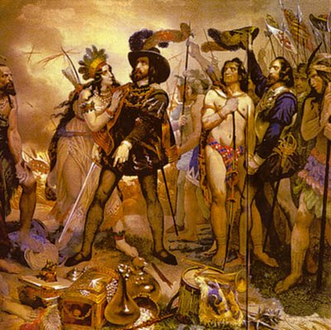
Spanish Settlements
Many missionaries came from Spain to convert Natives to Catholicism
Others came who became know as Conquistadors- their main goal was conquest and they brutally killed many Natives
Most early Spanish settlements were in South America, Mexico and the Caribbean

Slide 23
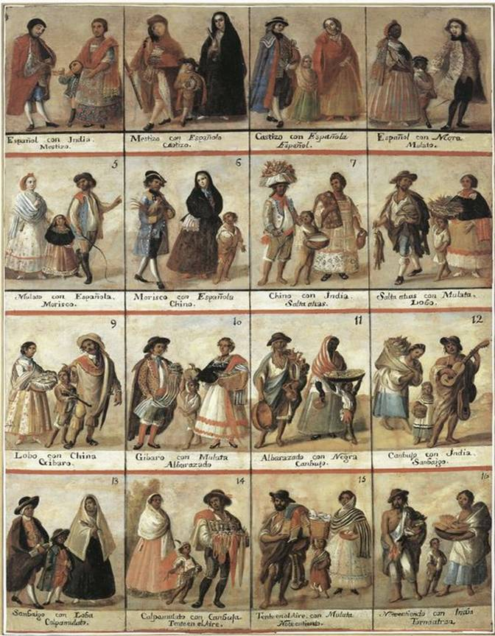
Spanish Settlements
The Spanish began to push northward and made settlements in Florida and New Mexico
Spanish colonists made money from some farming but mostly trade
Over 250,000 people immigrated to the Spanish Empire
Native Americans died off due to diseases and Mestizos (children of mixed race) became the largest part of the population

Slide 24
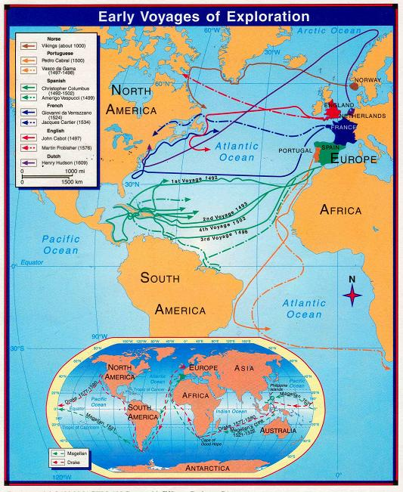

Slide 25
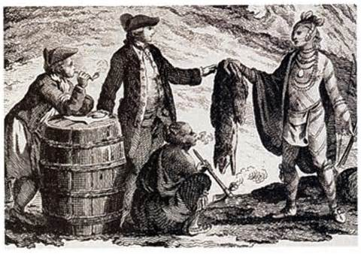
French Settlements
French Settlers wanted to find a Northwest passage, a route to connect to Asia
As they searched the Eastern coastline for a passage they encountered Native Americans who offered furs to trade for metal tools
The Fur Trade soon exploded and became a major economic draw for the French
The French relied on the Native Americans to help hunt beavers for furs and thus tried to keep good relationships with neighboring tribes

Slide 26
French Settlements
The new territory was called New France
The colony grew slowly as it attracted few colonists
Colonists were reluctant to clear the dense forests of the territory to make room for farms
The long cold winters in Canada were also a factor for deterring people
But though New France was a small colony, friendly relationships with the Natives allowed them to be successful in farming and trading
Later the French made settlements in Louisiana and New Orleans which they valued as military standpoints but were not as successful

Slide 27
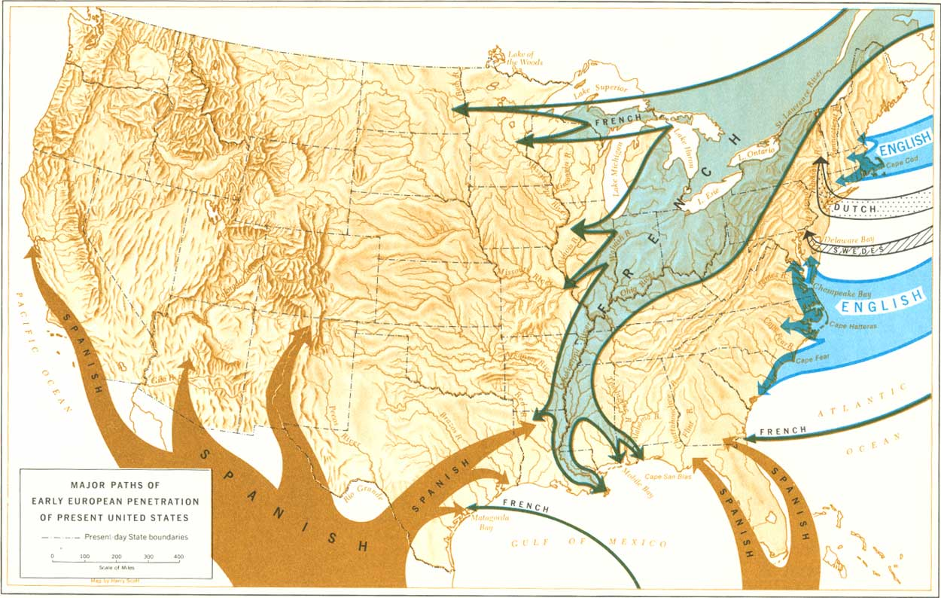

Slide 28
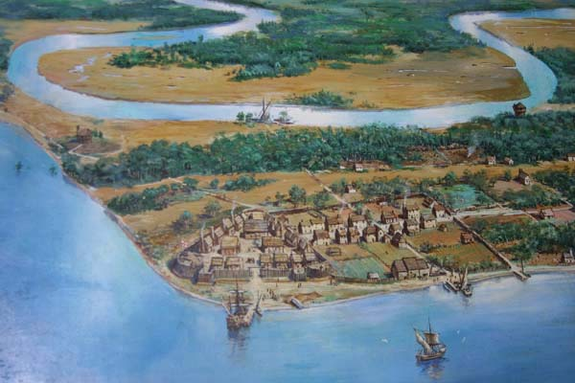
English Settlements
The first successful English settlement was in 1607 in Jamestown (which is now Virginia)
Early colonists were Protestants seeking religious freedom and riches
The English wanted to send poor people to work in the colonies to help boost their economy with farming
Early settlers dealt with war with the Indians, disease, and starvation

Slide 29
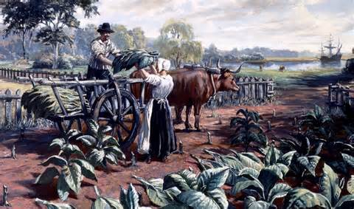
English Settlements
After years of hardship, the English led by John Rolfe started to grow tobacco as a cash crop
Tobacco was becoming widely popular in England and was the settlement’s savior
The profits attracted new settlers as did the headright system which promised free land to some settlers
Soon English colonies were quickly growing

