Slide 1
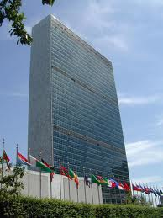
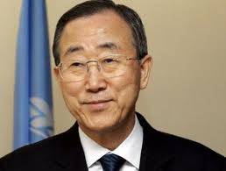
The United Nations
Introductory Notes

Slide 2
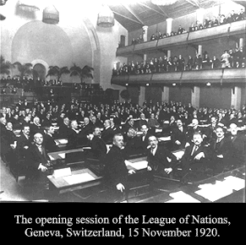
Before the UN
After WWI a League of Nations was established to try and prevent future wars from occurring
The League of Nations proved to be too weak to prevent WWII
The League lacked its own military power and many of its members would not carry out the League’s decisions

Slide 3
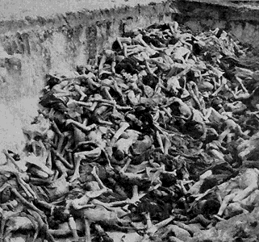
The Horror of WWII
During WWII, the world saw cruelty and evil that it never thought possible
Around 10 million Jews, Gypsies, Homosexuals, and people with disabilities were killed by the Nazis

Slide 4
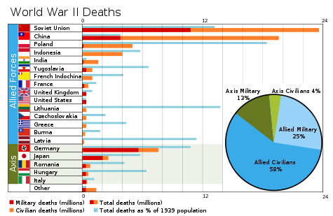
The Horrors of WWII Cont.

Slide 5
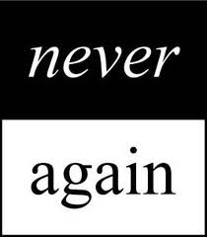

Slide 6
After WWII
As WWII raged on, several countries discussed the idea of a post-war organization similar to the League of Nations
They met in 1945 in San Francisco to create this new organization
50 countries attended
On June 26th, 1945 The Charter of the UN was signed

Slide 7
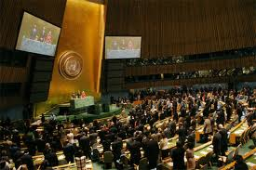
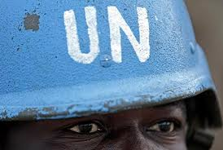
The UN
The UN is NOT a world government
The UN can NOT create laws
192 member countries
All UN member countries have a VOICE
All UN member countries have a VOTE

Slide 8
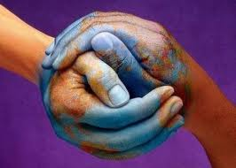
The Aims/Goals of the UN
To keep peace throughout the world.
To develop friendly relations between nations.
To work together to help people live better lives, to eliminate poverty, disease and illiteracy in the world, to stop environmental destruction and to encourage respect for each other's rights and freedoms.
To be a center for helping nations achieve these aims.

Slide 9
The Principles of the UN
All Member States have sovereign equality.
All Member States must obey the Charter.
Countries must try to settle their differences by peaceful means.
Countries must avoid using force or threatening to use force.
The UN may not interfere in the domestic affairs of any country.
Countries should try to assist the United Nations.

Slide 10
The Structure of the UN

Slide 11
The Structure of the UN
General Assembly (NY)
Security Council (NY)
Economic and Social Council (NY)
Trusteeship Council (NY)
Secretariat (NY)
International Court of Justice (Netherlands)

Slide 12
Secretary General of the UN- Ban-Ki-Moon
He is the leader of the UN, presides over the Secretariat and is the face on the UN

Slide 13
General Assembly
The main structure of the UN
Made up of all UN member states- each has one vote
Decisions on important issues require two thirds majority
Main functions: Maintain peace, make recommendations to security council, promote international cooperation, promote human rights

Slide 14
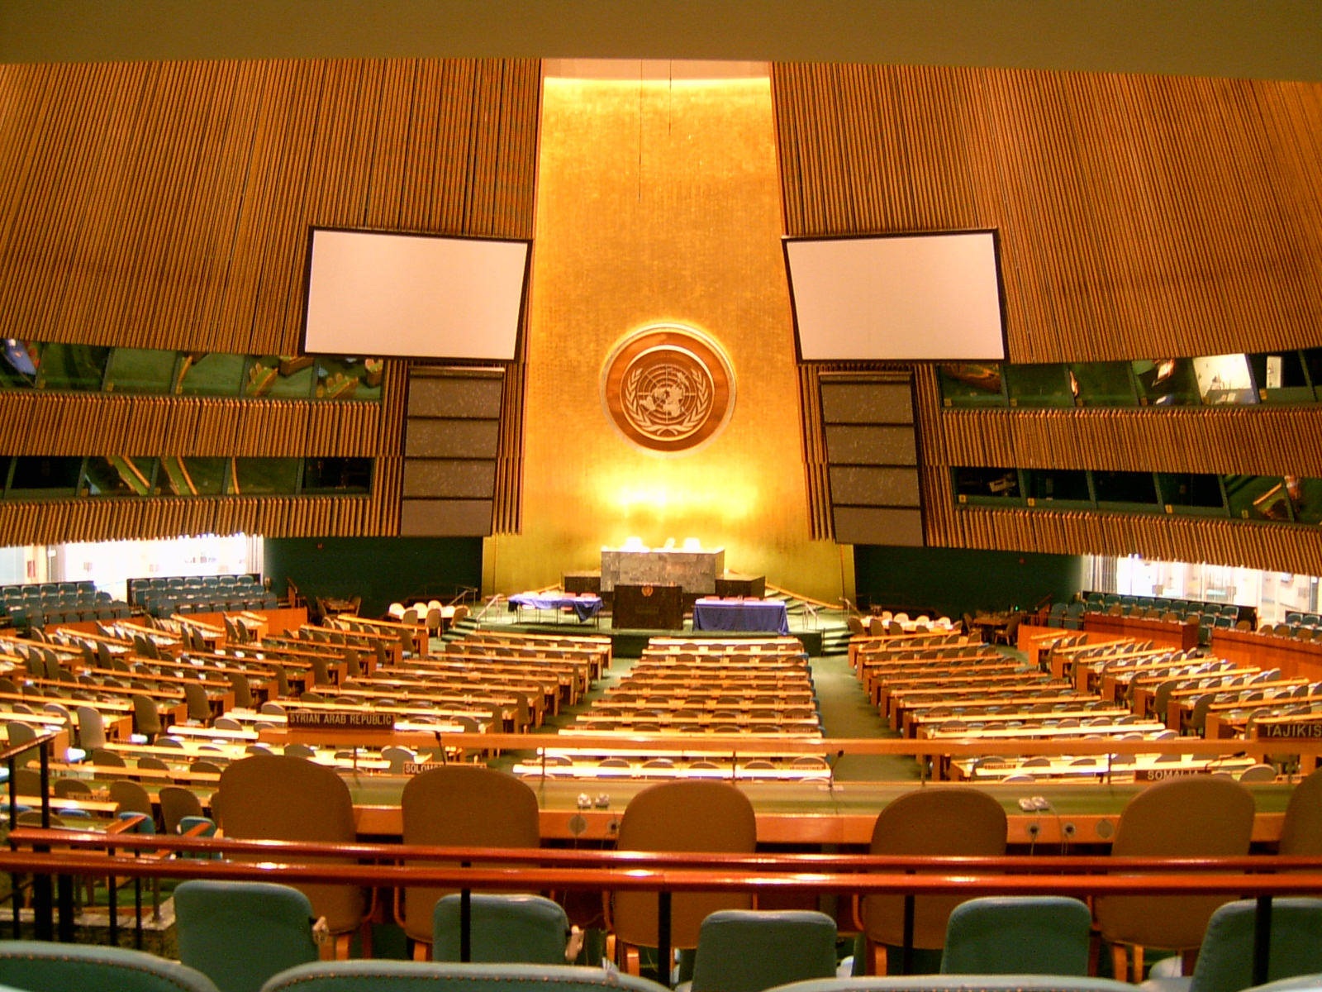

Slide 15
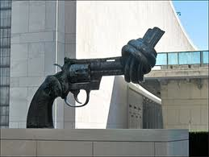
Security Council
Primary responsibility to maintain peace and security
15 Council Members
5 Permanent Members
China
France
Russia
United Kingdom
United States
10 Non-permanent members that serve two year terms

Slide 16
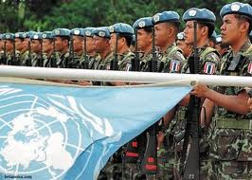
Security Council Cont.
Powers of the Security Council
Tries to ensure a ceasefire
May send peacekeeping troops
Impose economic sanctions
Rare occasions “All means necessary”

Slide 17
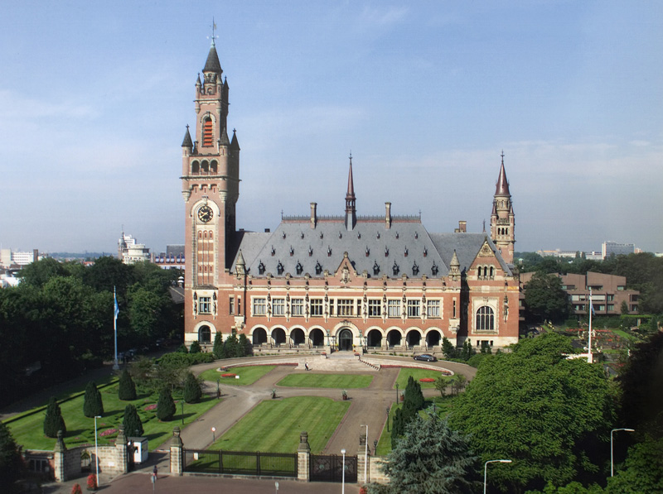
International Court of Justice
Hears cases involving international government issues
Clarifies questions of international law
Interprets the UN charter

Slide 18
Other UN Branches
Economic and Security Council
54 member council
Serves as central place to discuss international economic issues
Trusteeship Council
Established to promote developing countries towards independence
Secretariat
Carry out day to day tasks
Prepare studies on UN
Inform media about UN missions

