Slide 1
Japanese-American Internment
February 17 and 21, 2017

Slide 2
How did this happen?
Pearl Harbor (December 7, 1941) made many Americans nervous about Japanese spies.
President Roosevelt signed Executive Order 9066, which created military zones.
The first evacuations began in March 1942.

Slide 3
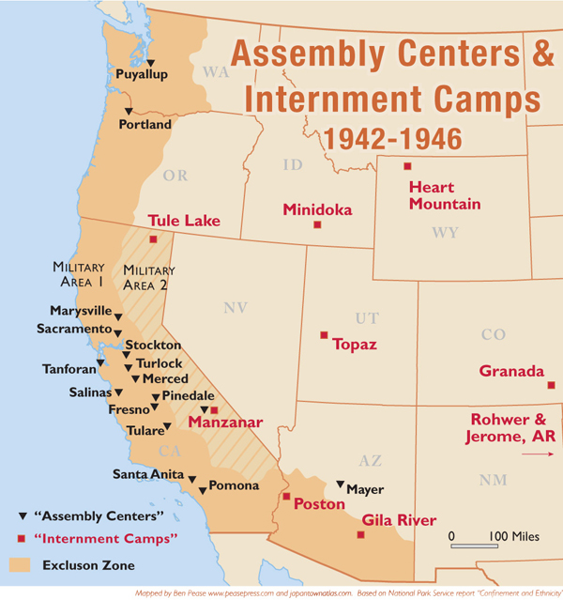
Map of the War Relocation Centers

Slide 4
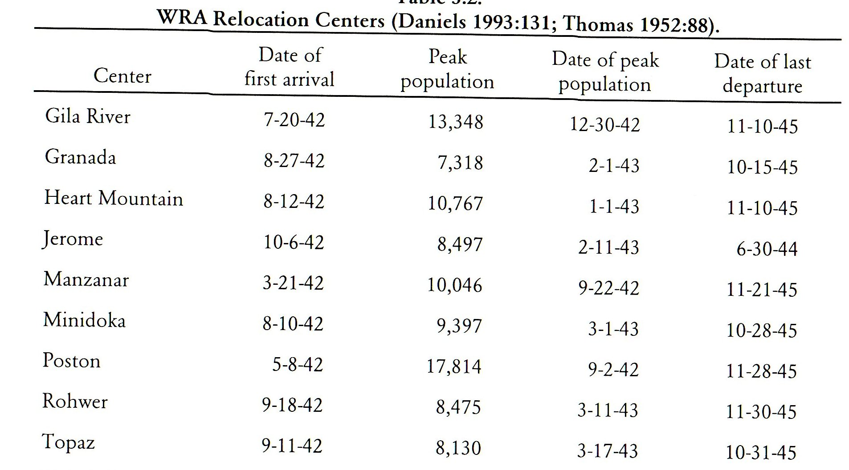

Slide 5
The end of internment (two cases)
In Korematsu vs. US, the Court found that the removal of Japanese-Americans was constitutional.
However in Ex parte Endo, the Court ruled that loyal citizens could not be detained.
The exclusion order was canceled in January 1945 and Japanese American began to return home.

