Slide 1
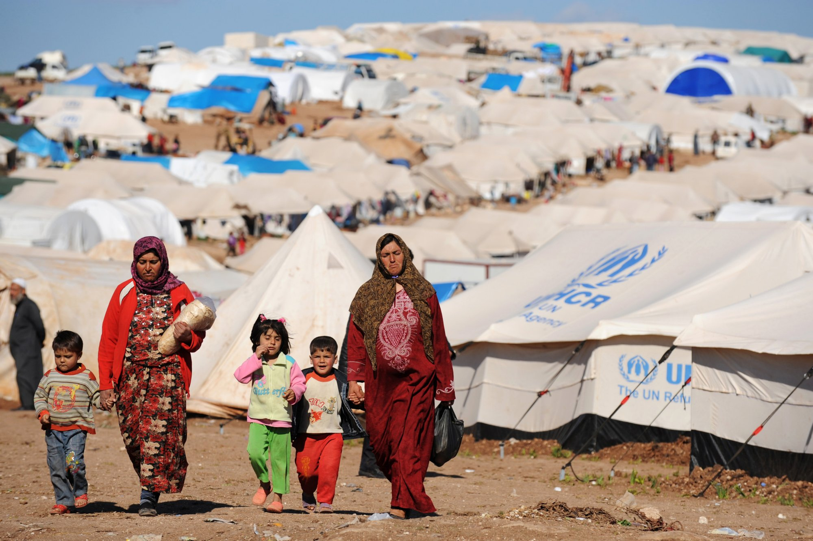
Global Studies- Model UN Simulation

Slide 2
Welcome to the UNHCR
Today we are here to discuss the current Syrian Refugee Crisis.
Remember that our 2 main issues for today are:
The Syrian conflict
Protecting the rights of refugees
Our Goal: Come to an agreement that outlines next steps for the UNHCR

Slide 3
Step 1
Country Presentations- Each group presents an overview of their countries involvement in the Syrian Crisis
(one minute/country).
Discuss which side you are on and how you have been involved.

Slide 4
Step 2- Position Statements
Each country provides their positions on the TWO issues (one minute/country).
Record the positions on your paper to reference back to.

Slide 5
Step 3
Finding Common Ground- After hearing from the other countries, answer the questions on your worksheet:
1.Which countries are you most aligned with? Which countries have similar interests in this situation?
2. Which countries are most dissimilar and will be the biggest threat to your agenda?
After you finish writing down your answers, take 10 minutes for one-on-one negotiations. Your countries are free to move around the room and meet with other countries to make deals.

Slide 6
Step 4
Negotiation time (5-10 minutes to discuss with other countries)
You will be responsible for passing resolutions regarding BOTH issues. You can pass as many resolutions as you can with a total UN budget of $240 million USD.

Slide 7
Step 5
Voting- Countries bring resolutions to the whole group.
Countries will vote on resolutions.
You need to have at least SIX countries in agreement to pass a resolution.

Slide 8
Proposed Resolutions.
-Syria will pay $2 million to every country for its refugees in exchange for keeping Turkey out of the conflict.
-US will give 25,000 troops to Iran to fight ISIS and $2.1 million to Turkey for refugees.
-Russia and US will fund Iran accepting refugees from Assad’s territory and help them protect their border.
-US gives Germany $2.1 million/year to take in 500,000 refugees.
-France will support/supply other countries in their fights against ISIS but stay out of conflict.
-France will accept small groups of overflow refugees from Germany for funding.
-Lebanon will fight ISIS as long as France and Russia take 5,000 refugees each.

Slide 9
Debrief
Take time to reflect on today…
How do you think the process went? Did you reach a resolution?
Were you prepared? Why or why not?
Was it realistic? Do you think the result would actually work?
Were you happy with the results? Why or why not? What could’ve been improved?

