Slide 1
The Revolutionary War

Slide 2
Put the following events in order
A. First Actual Battle of the War: Lexington and Concord
B. French and Indian War is fought
C. British pass acts to Tax Goods in America
D. Boston Tea Party occurs
E. Intolerable Acts Passed

Slide 3
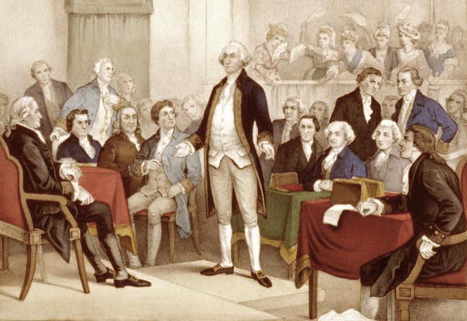
Road to Revolution
After the Intolerable Acts, the colonists formed the First Continental Congress
Group discussed problems with King, didn’t call for independence yet
Britain saw it as a sign of rebellion
Ordered troops to Lexington and Concord to keep watch

Slide 4
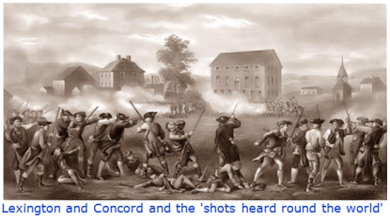
Lexington and Concord
The first shots of the war were fired in April 1775
Over 250 British Red Coats were killed
100 American Colonists also lost their lives

Slide 5
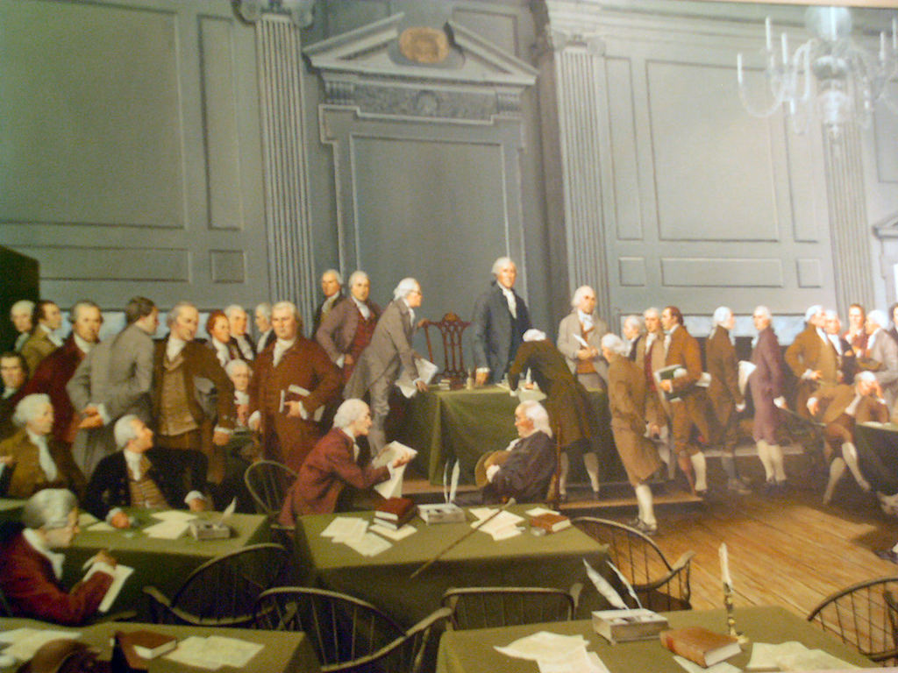
Second Continental Congress
Met on May 10, 1775 in Philadelphia
Gave money to war- formed the Continental Army
Elected George Washington as the Commander of the military
Wrote the Declaration of Independence

Slide 6
Military Strategies
American Tactics
Attack British supplies-British had many more weapons, canons, ships
Wear the British down, don’t have to win every battle
Make an alliance with one of Britain’s enemies.
British Tactics
Break the colonies in half by getting between N & S
Blockade the ports to prevent the flow of goods and supplies from an ally.
“Divide and Conquer” → use the Loyalists.

Slide 7
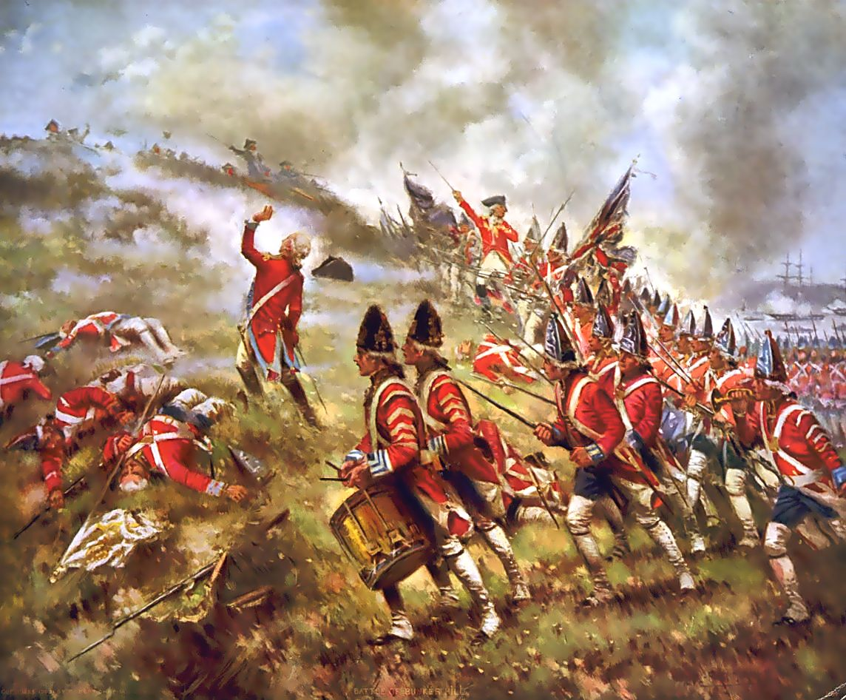
Bunker Hill (June, 1775)
The continental army faced British troops twice their size
Commander ordered, “Do not fire until you see the whites of their eyes!”
His troops had the courage and discipline to hold their fire until the enemy was near
The British suffered over 40% casualties.
This was a key victory for the colonists

Slide 8
Saratoga- Oct 7,1777
This was the turning point for the war
British commander was trying to isolate New England
His plans were thwarted when his allies didn’t come to his aid and he was overpowered
Almost 6,000 British surrendered
Victory gave the French the encouragement they needed to ally with the Americans

Slide 9
Yorktown- 1781
British General Cornwallis was waiting in Yorktown for supplies and reinforcements
The Americans and French planned to stop this before it could happen
The Americans marched by land to battle the British
French ships were able to stop British supply ships
He was forced to surrender in October 19, 1781

Slide 10
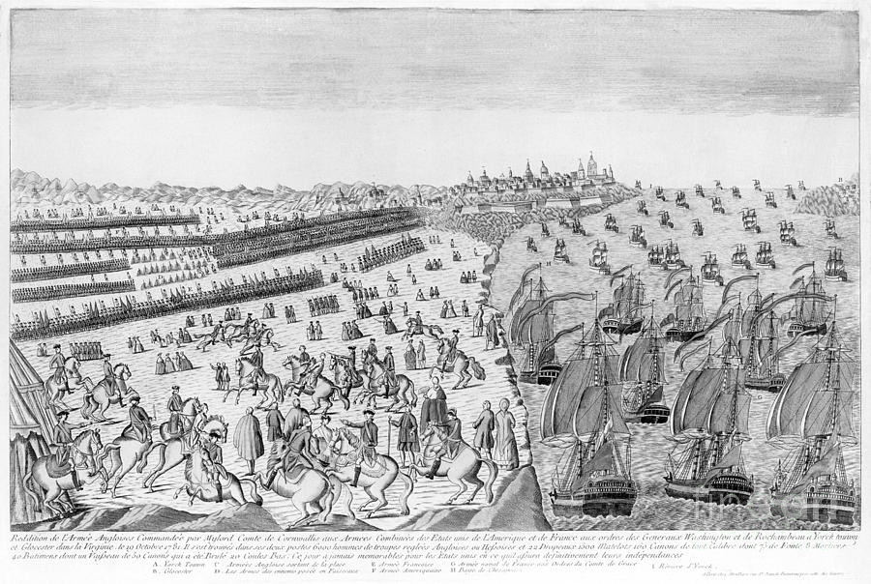

Slide 11
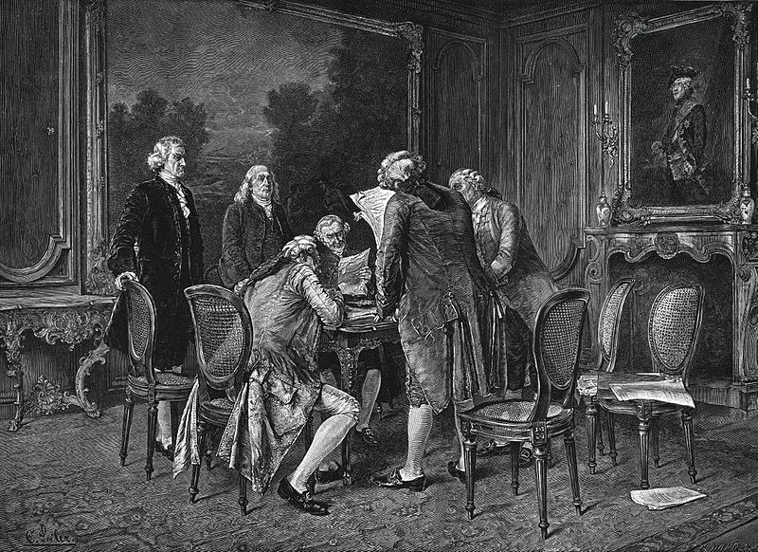
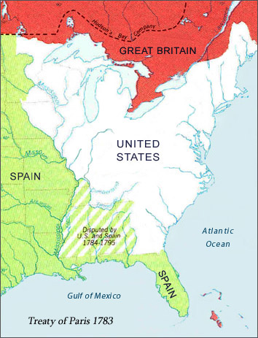
Peace of Paris
After Yorktown, the British people had grown tired with the war and voted to end the war
The final peace treaty was signed in Paris on September 3, 1783
It gave the colonists their long hoped for independence
It sent the Mississippi river as the westward boundary and a northern boundary with Canada

Slide 13
Timeline Major Assessment
Your task is to create an annotated timeline of the major events of the Revolutionary War. Your final product may be a poster, PowerPoint, Prezzi, or word document.
Due Date: A Day: September 30th
B Day: October 3rd
You will have 2 ½ class periods to work and one full work day in class

Slide 14
Your timeline must include: (10 events total) 3 events leading up to the Revolutionary War- Causes 4 events during the Revolutionary War- 2 of these must be events we did not discuss in class (That means you will have to research them) 3 events about the outcome and end of the Revolutionary War- | Each event must include: Event Title or Name Date 4-5 Sentence Description Image- can be hand drawn or computer generated Citations for sources used

