Slide 1
Colonial Taxation

Slide 2
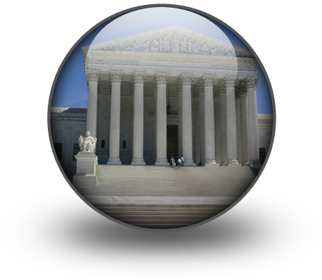
Your presenters should have a paper to show the other groups that looks like this: Title of Act- Date
Purpose of the act/ What it taxed:
Outcome and Response:

Slide 3
Roles
Presenter: Travel from group to group to present the information : You will have 3 minutes to present
Artist: Make a visual and information sheet for the presenter to take with them (step 4)
Timekeeper: Keep everyone on task and on time
Reporter: You will be responsible for teaching your presenter what they missed
EVERYONE ASSISTS IN COMPLETING THE TASK

Slide 4
1st
-Assign Roles
1 min
2nd
-Read aloud
5 min
3rd
-Prepare for Round Robin Poster (10- 15 min)

Slide 5
4th
-The presenter presents their vignette to another group (3 minutes)

Slide 6
6th
-Presenters Rotate (3 minutes)

Slide 7
Finally
-Share out in groups

Slide 8
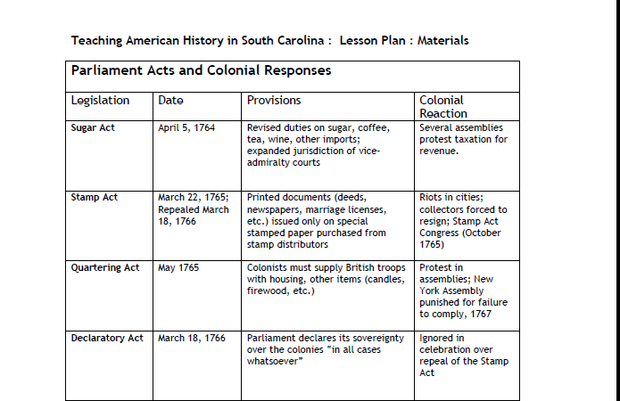

Slide 9
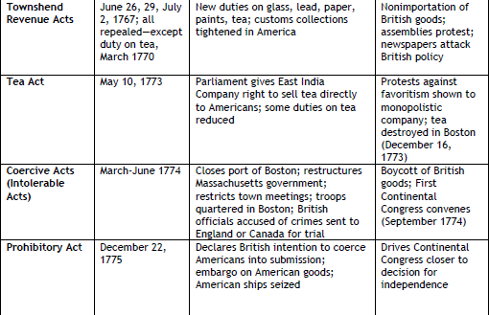

Slide 10
The Boston Tea Party
The tea act was the last straw for some colonists
Members of the Sons of Liberty, an organization that supported colonial rights decided they had to fight back
Let’s watch what happened…

Slide 11
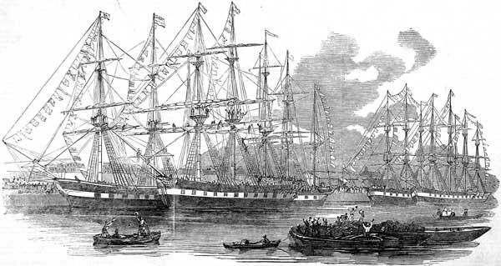

Slide 12
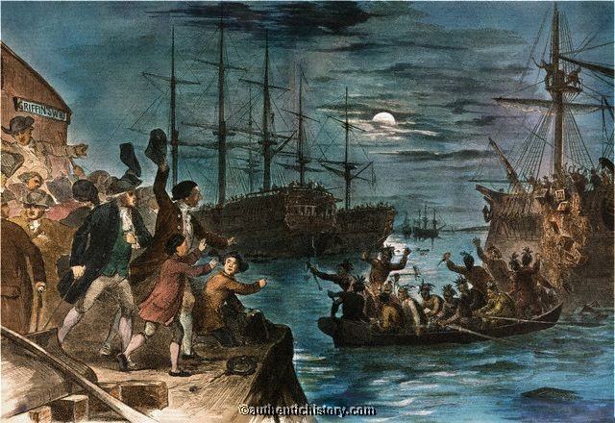

Slide 13
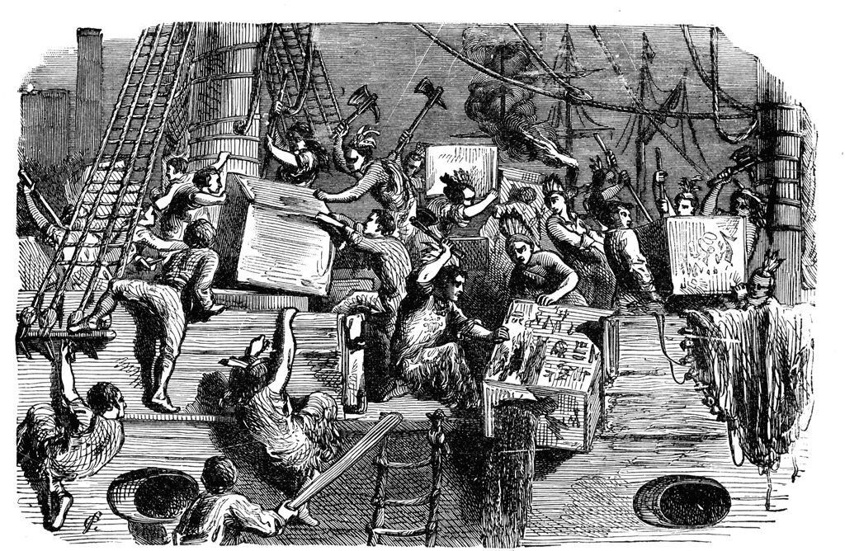

Slide 14
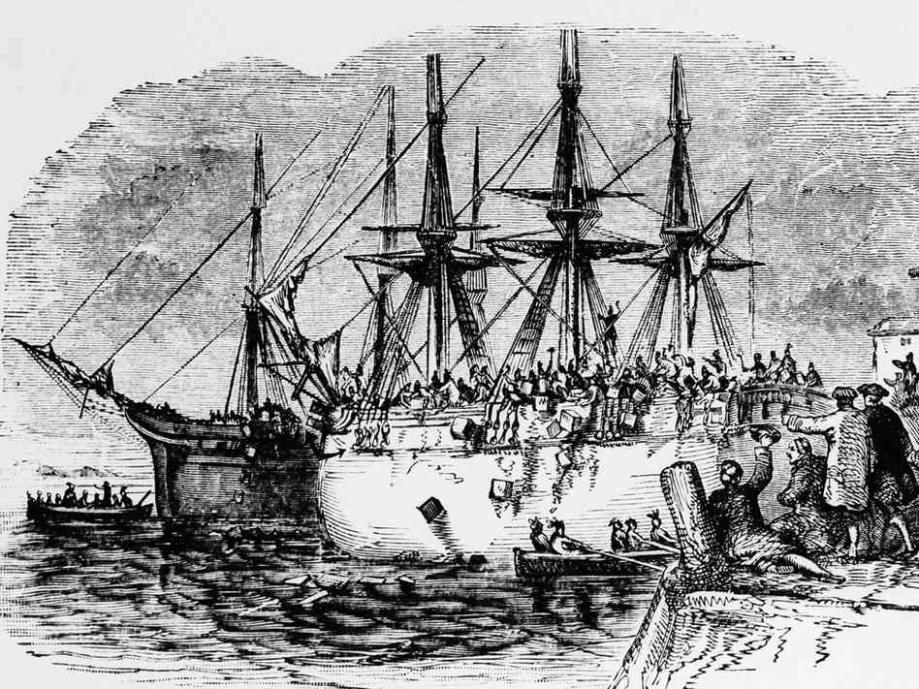

Slide 15
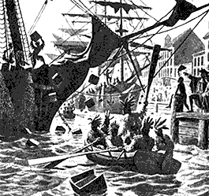

Slide 16
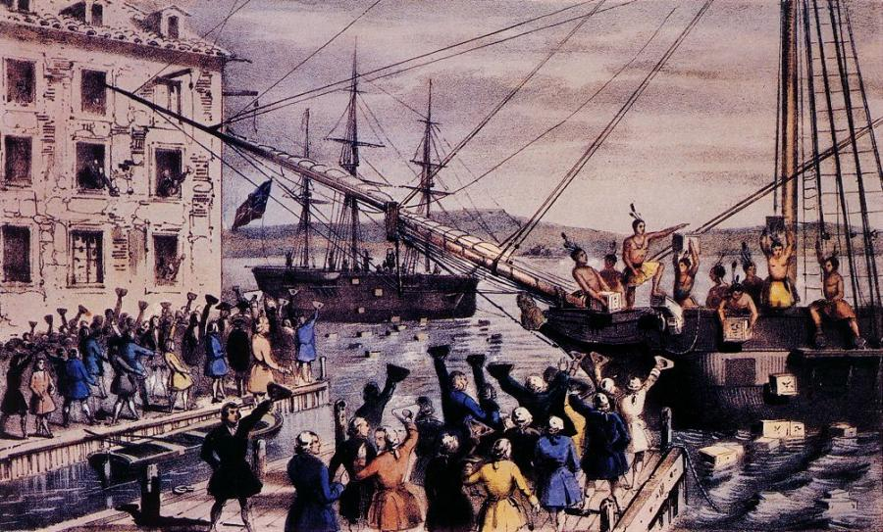

Slide 17
Responding to the Boston Tea Party…
The British did not let the Boston Tea Party go unpunished
In 1774 they passed the Intolerable (Coercive) Acts
The Intolerable Acts were a package of five laws implemented by the British government with the purpose of restoring authority

Slide 18
The Intolerable Acts
The Boston Port Act- Closed the port of Boston
Massachusetts Government Act- Severely restricted the ability of colonial assemblies to meet, banned many committees
The Administration of Justice Act- limited the ability of colonial courts to try British officials
The Quartering Act- same as the old quartering act, forced colonies to house British soldiers
The Quebec Act- enlarged the land that belonged to Quebec which was majority French, this boosted French loyalty which the English hoped would come in handy

Slide 19
Intolerable Acts cont…
Resistance gave rise to the creation of the First Continental Congress
The First Continental Congress was made up of delegates from each colony and first met in Philadelphia
One of the famous attenders, Patrick Henry coined the phrase “Give me liberty or give me death”
He also later stated “The distinctions between Virginians, Pennsylvanians, New Yorkers, and New Englanders are no more. I am not a Virginian, but an American.”

Slide 20
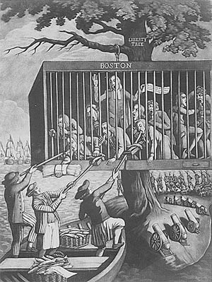

Slide 21
