Slide 1
The Gilded Age and Big Business

Slide 2
Gilded Age
The time period from Reconstruction to the turn of the century, 1870-1920
Huge changes in technology and urbanization
Millions moved to cities
40% of Americans lived in cities by 1900, compared to only 20% in 1860

Slide 3
People left for the appeals of the city- In the box on your paper, record some of the draws of the city you see on the next few slides

Slide 4
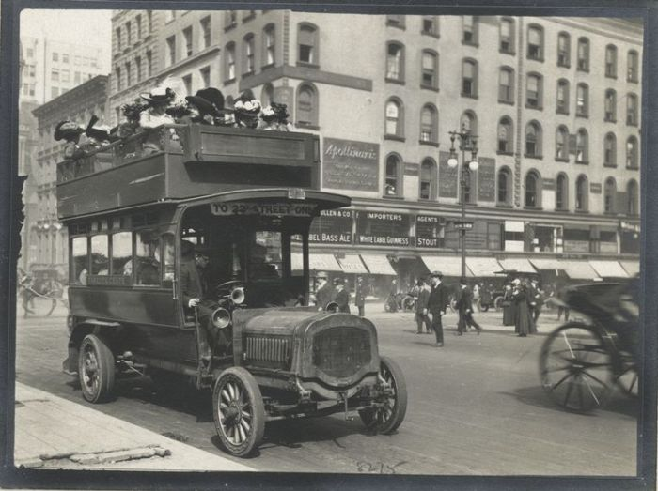

Slide 5
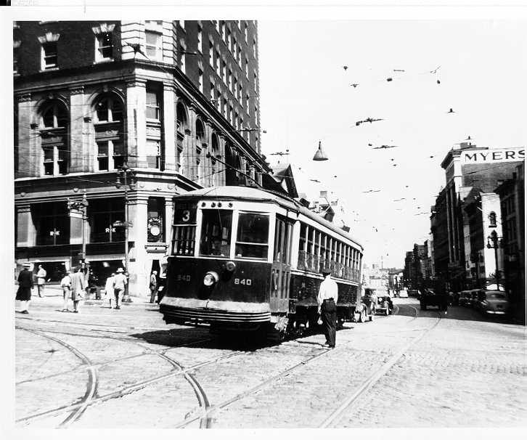

Slide 6
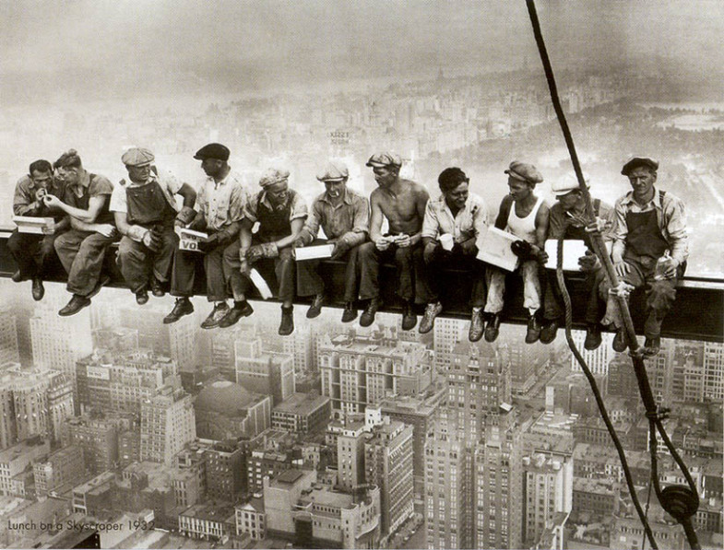

Slide 7
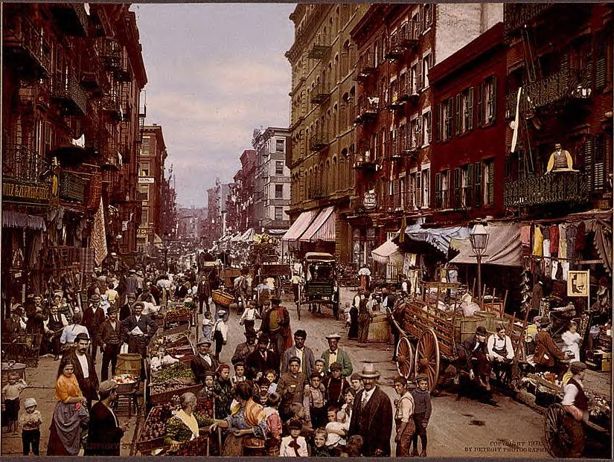

Slide 8
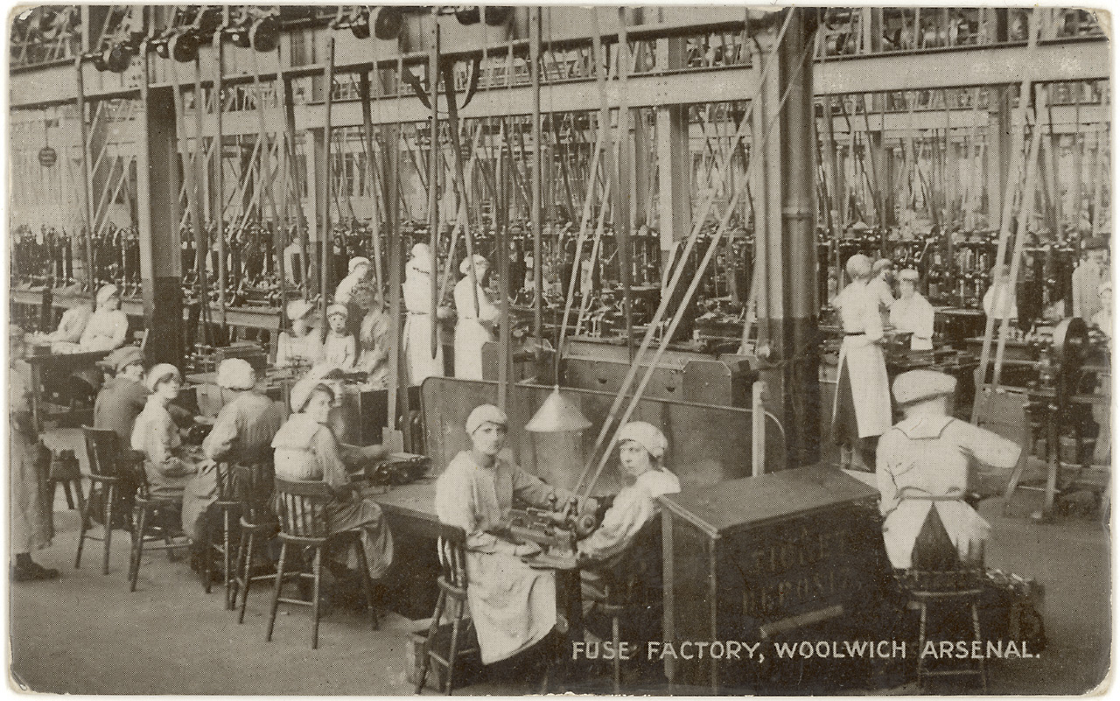

Slide 9
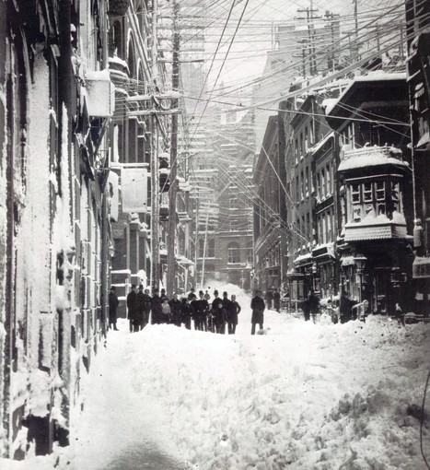

Slide 10
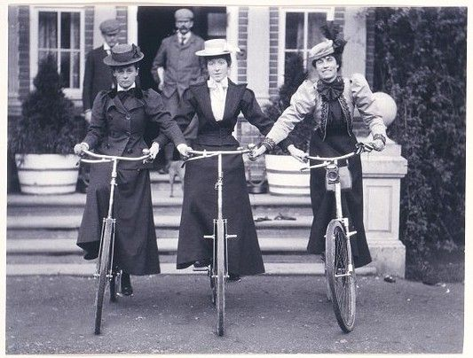

Slide 11
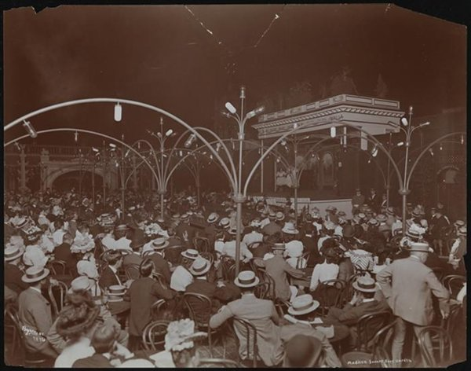

Slide 12
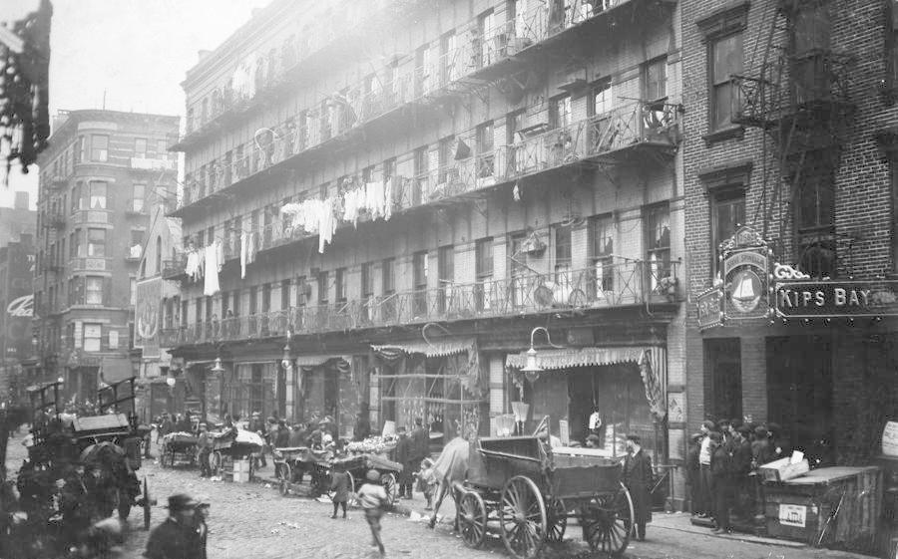

Slide 13
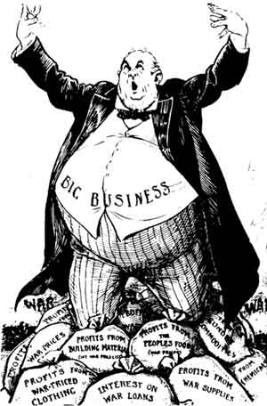
Gilded Age Cont.
There was a rise in the Middle Class and the Upper Class
There was also the start of Big Business
There was little regulation of business which allowed Monopolies to develop
A Monopoly is when one business controls all the means of production for an industry or has exclusive control of an industry

Slide 14
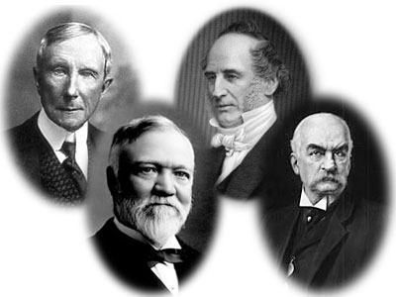
Big Business
New technologies led to huge business opportunities
People were making money at record speed, the first billionaires were made
Tycoons were wealthy and powerful business men who began to dominate power in America
Carnegie- Steel
Morgan- Finance
Rockefeller- Oil
Vanderbilt-Shipping and Rails

Slide 15
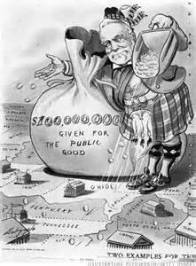
Captain of Industry
During the Industrial Revolution, a captain of industry was a business leader whose means of amassing a personal fortune contributed positively to the country

Slide 16
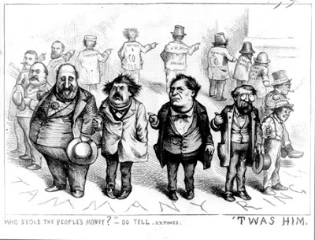
Robber Baron
Robber baron became a derogatory term applied to wealthy and powerful 19th-century American businessmen who used the people below them and did not care about proper business practices

Slide 17
Look at the quotes below. Read each quote and decide if the author would be a robber baron or a Captain of Industry

Slide 18
Quote 1
Quote 1: This, then, is held to be the duty of the man of wealth: First, to set an example of modest, unostentatious living, shunning display or extravagance; … the man of wealth thus becoming the mere trustee and agent for his poorer brethren, bringing to their service his superior wisdom, experience and ability to administer, doing for them better than they would or could do for themselves." —From "Wealth," by Andrew Carnegie, North American Review (1889)

Slide 19
Quote 2
"Law? Who cares about the law. Hain't I got the power?" —Comment alleged to have been made by Cornelius Vanderbilt, when warned that he might be violating the law

Slide 20
Quote 3
The man who becomes wealthy is in a measure successful, but only so far as the acquirement sharpens his intellect, broadens his powers, and develops him into a self-reliant, powerful member of society for its good. Selfish wealth is never good. One may be a millionaire, but if with it comes greed, avarice, oppression of others, the success is small indeed. Scattered along the path of life we find examples of men whose success brought them fame and glory and proved an unqualified blessing to all mankind. . . .

Slide 21
Quote 4
“What good is $10 million if you can’t have real money.”
A statement from Jesse Livermore explaining his suicide in the 1930s. Livermore was a famous Wall Street speculator of the 1920s who lost most of his wealth in the Depression. At the time of his suicide, creditors were closing in but he still possessed $10 million.

Slide 22
Stations Rules
Step 1: Select roles, assign each person a number from 1-4
Person 1 will be responsible for being your “runner” and getting and returning materials
Step 2: Stay within the time frames
If you finish ahead of time, do not move on and do not get off task
Step 3: Each station will start with independent time to review your document and answer questions 1-3
Step 4: Independent time will be followed by share time, Everyone must share during share time if the order of their number (Person 1 then 2 then 3 then 4)
Step 5: After share time, work together to answer the remaining questions in this station
Step 6: Gather materials, send up runner when time finishes
Step 7: Repeat!!

