Slide 1
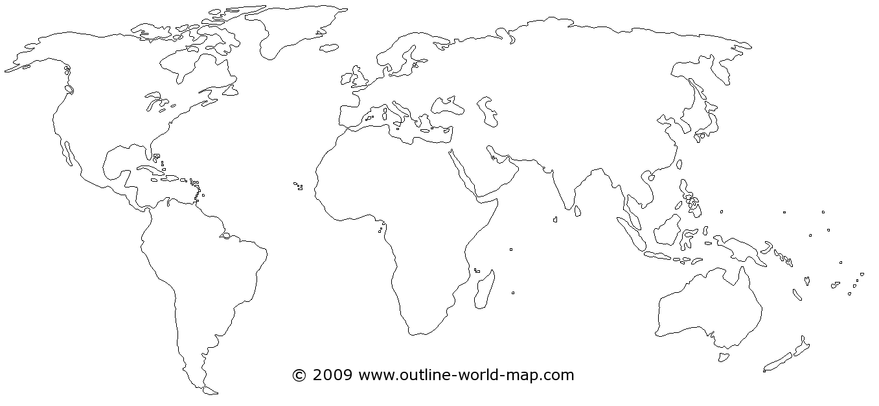

Slide 2
The Materials Economy

Slide 3
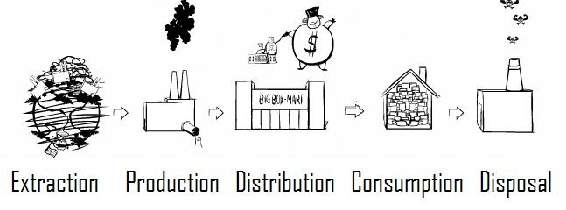

Slide 4
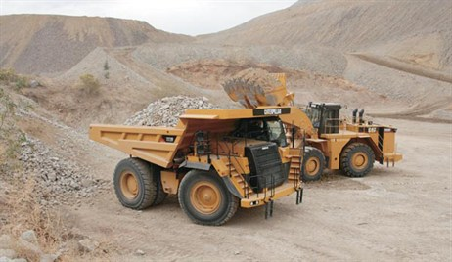
Step 1: Extraction
Definition: Removing natural resources from the earth
Cutting down trees, mining for ore, using water resources, killing animals for food or clothing, farming, fossil fuels
The earth has a finite supply of resources
The US has 5% of the world’s population and uses 30% of the world’s resources

Slide 5
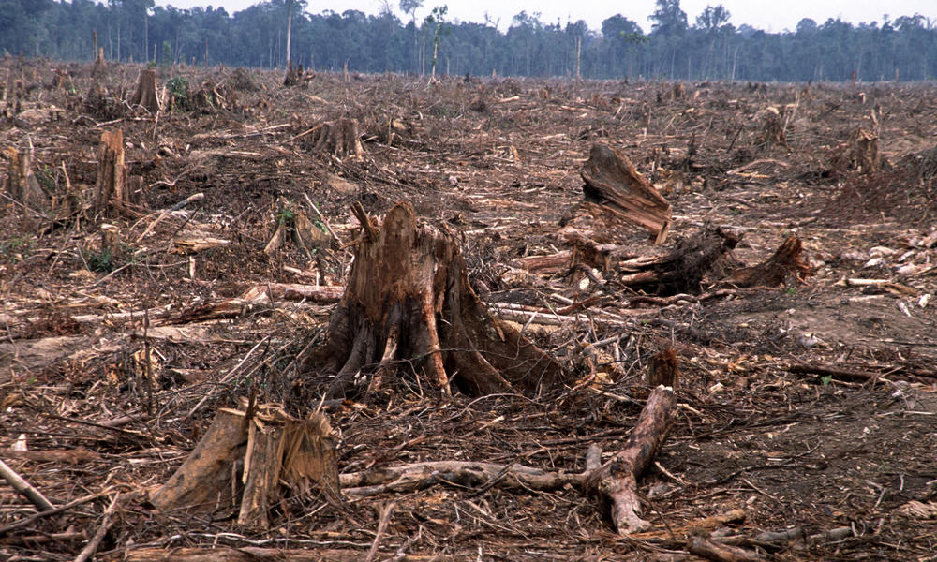
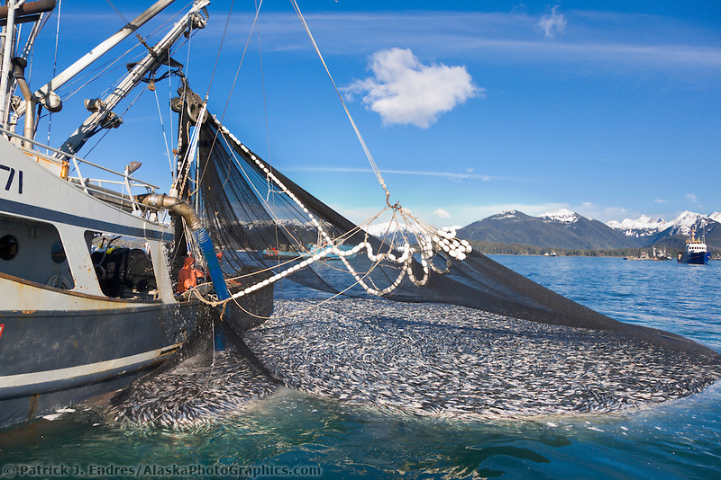
Some scary numbers about extraction
75% of global fisheries are fished beyond capacity
80% of the planet’s original forests are gone
We lose 2000 trees a minute in the Amazon rain forest

Slide 6
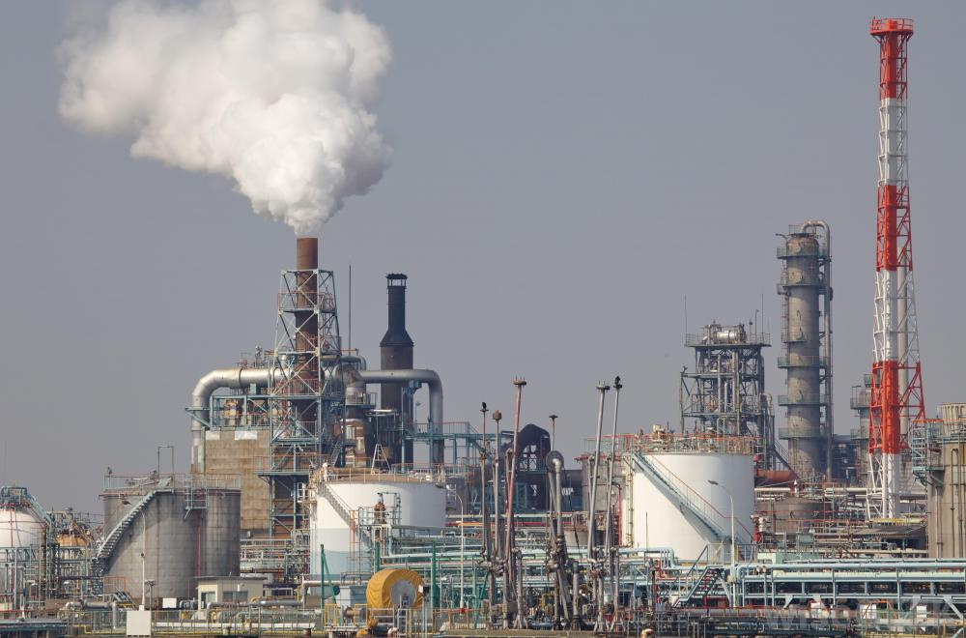
Step 2: Production
Definition: adding energy (and chemicals) to natural resources to make products
Raw goods are manufactured into usable products
Often exposes workers in the production stage to harmful chemicals
Many factories move to less desirable land (or countries) to produce due to toxic outputs of factories

Slide 7
Step 3: Distribution
Definition: Transporting and selling products
Manufactured products are transported to stores and places of commerce
Trucks, planes, ships, trains, human transport
All of these use fuel and produce waste

Slide 8
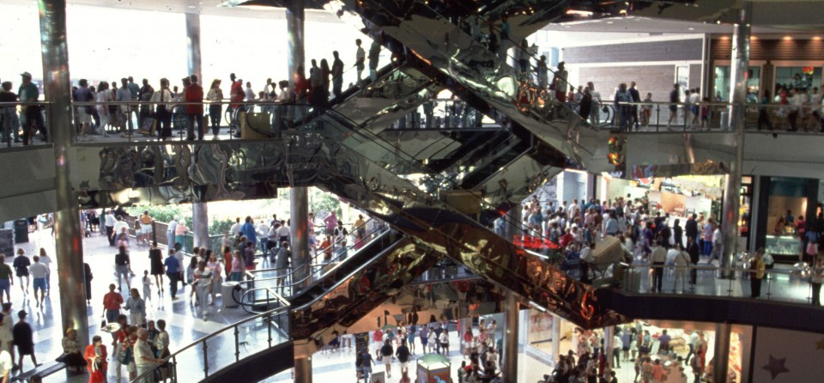
Step 4: Consumption
Definition: Purchasing and using the products
Driven by ads- consumer culture
Average product is used for 6 months before it is trashed

Slide 9
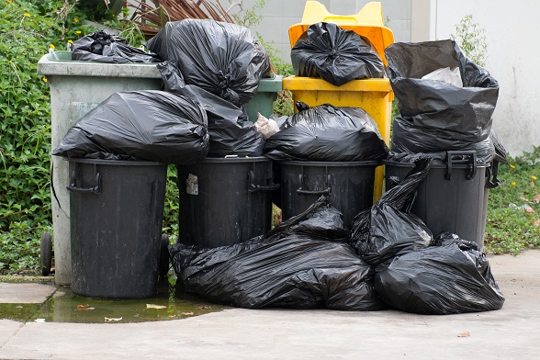
Step 5: Disposal
Definition: getting ride of waste- usually trough dumping, burning, or being recovered for recycling
An average American makes 4 ½ pounds of trash per day
For every garbage can that is put on the curb 70 cans of waste were made just to extract, produce, distribute it
Recycling helps to push products back into the materials economy but not everything can be recycled

Slide 10
Let’s Review
For each image on the next slides decide which part of the materials economy it represents
Place the number in the box at the bottom of the page to review

Slide 11
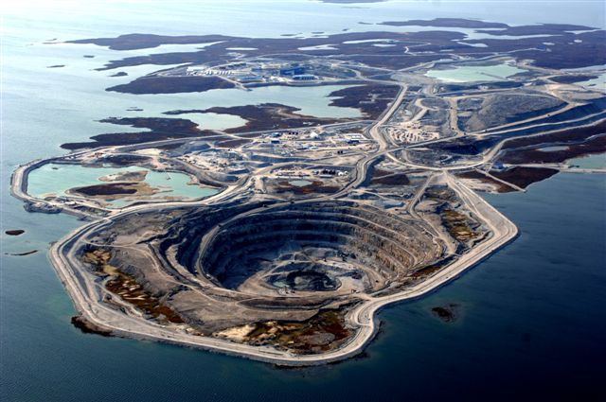

Slide 12
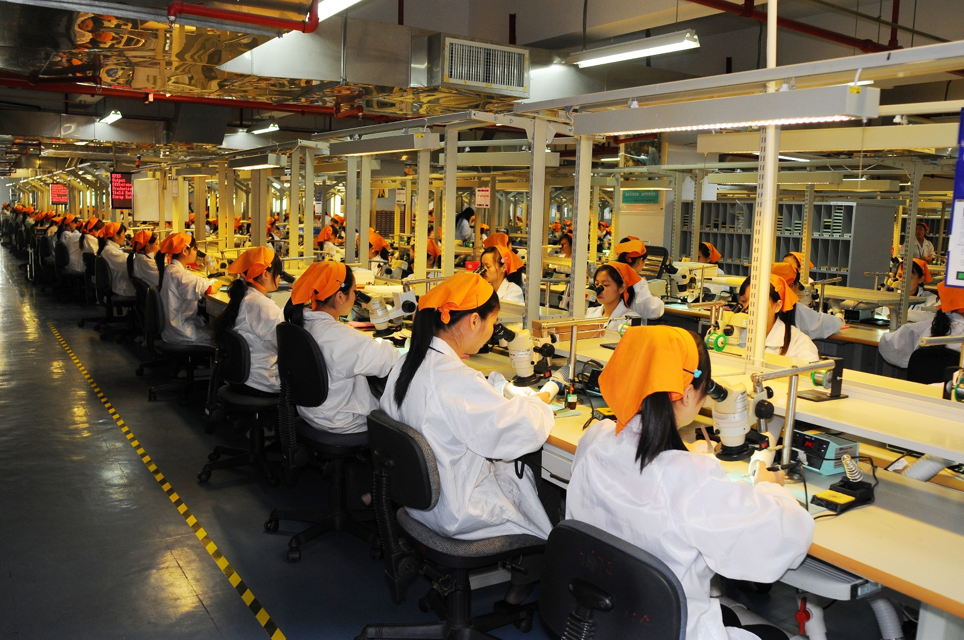

Slide 14
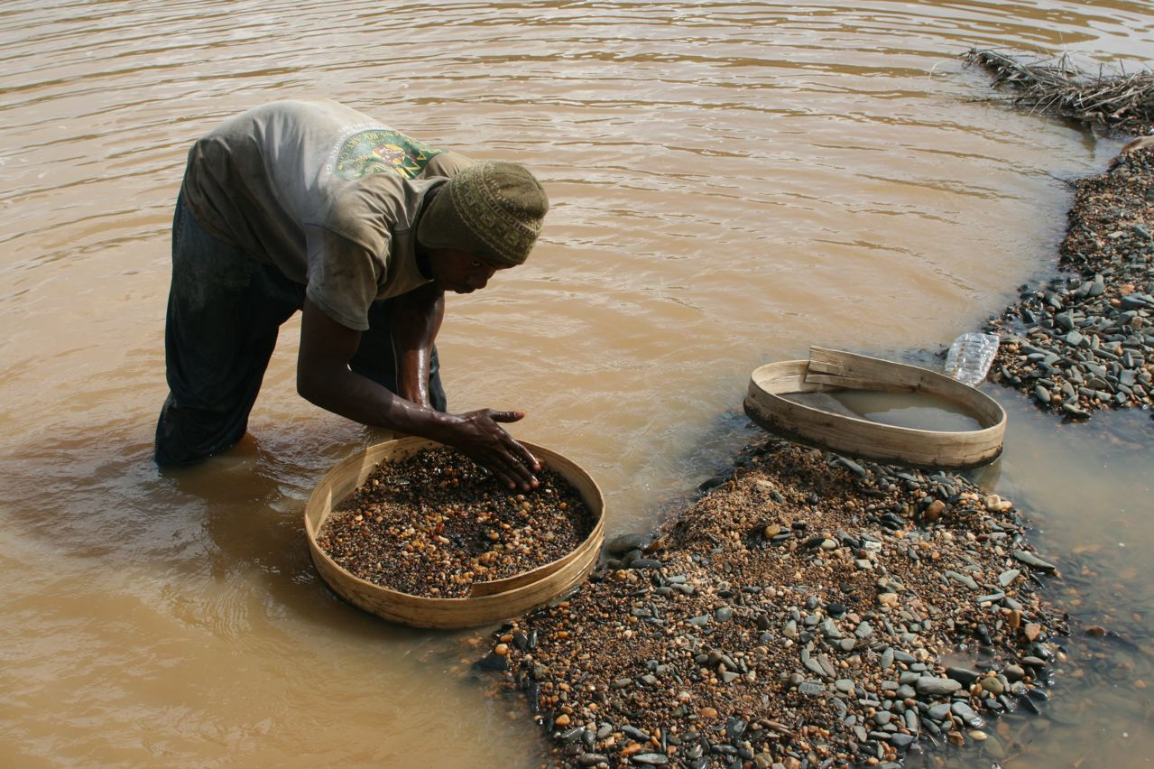

Slide 15
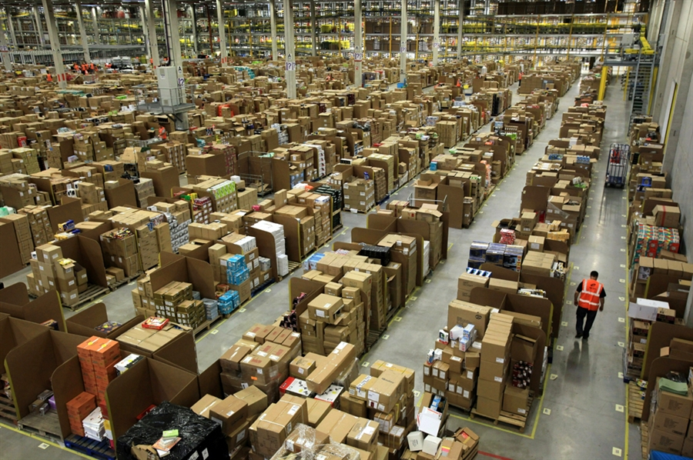

Slide 16
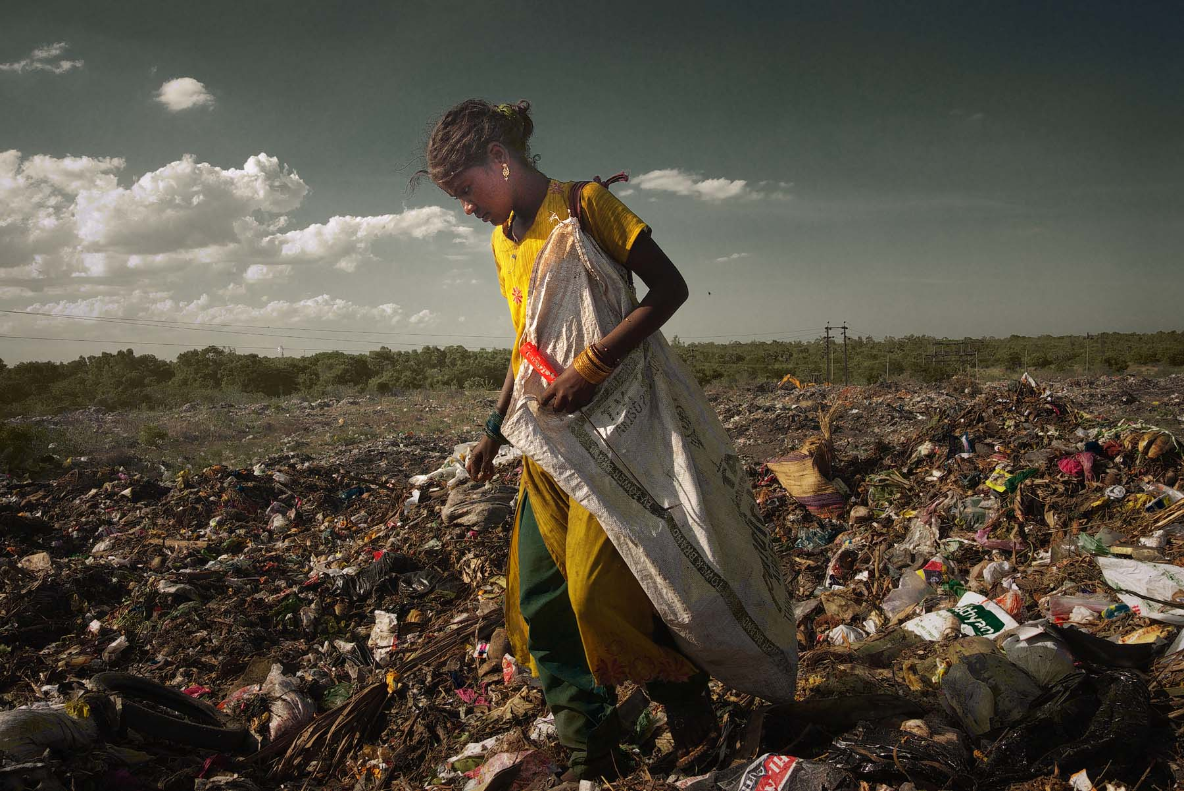

Slide 17
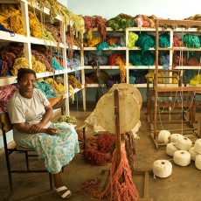

Slide 19
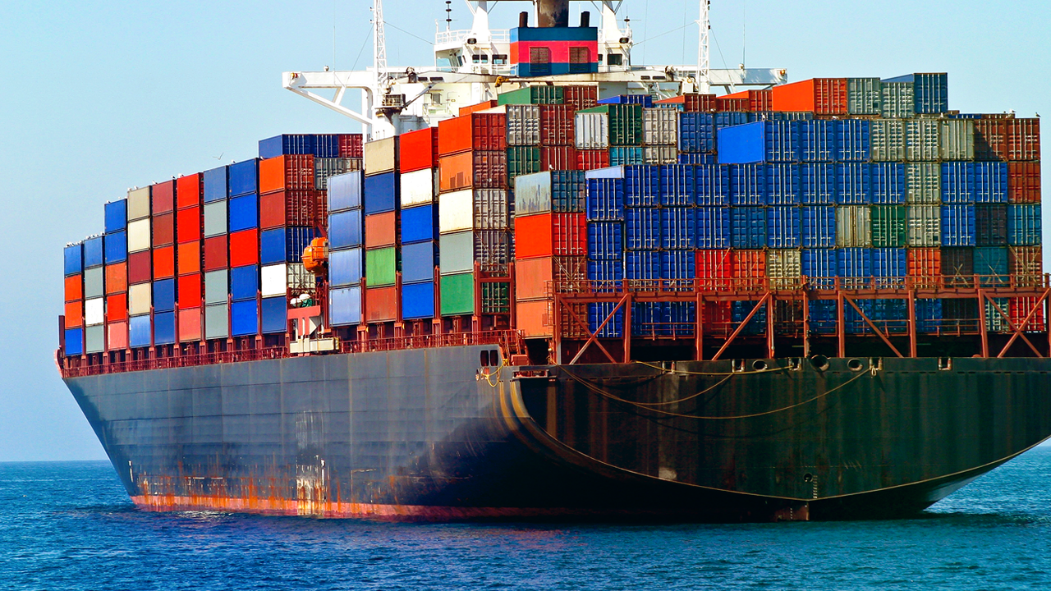

Slide 20
