Slide 1
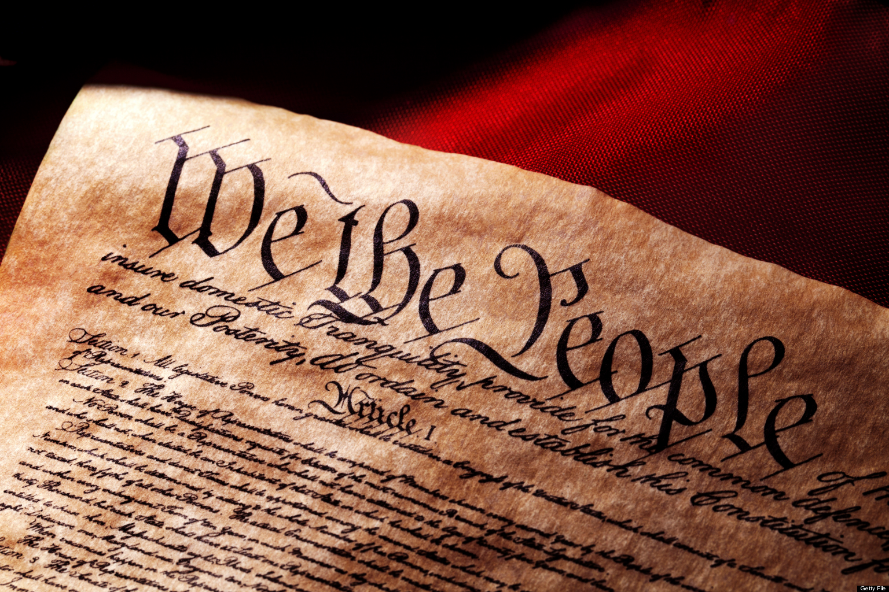
Student Name
Revolutionary War Timeline
Causes, Effects, and Outcomes
September 29, 2015

Slide 2
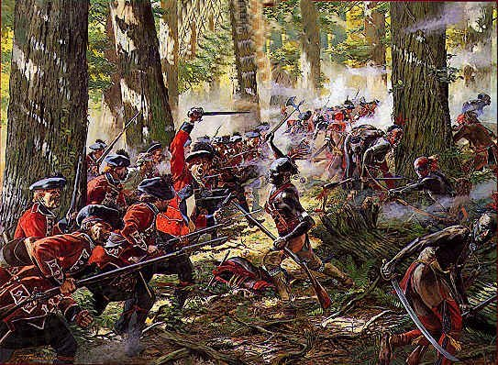
Cause 1: ___________________ (1763)
One of the first causes of the Revolutionary War was….
This event occurred because…
(Explain how the event ended.)
Author’s Last, First Name. “Title." Website Name. Publisher/Organization. Date Published. Web. 00 Sept. 2016.

Slide 3
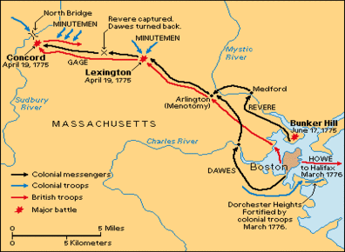
During: ___________________ (1775)
During the Revolutionary War, ____________ occurred….
This event occurred because…
(Explain how the event ended.)
Author’s Last, First Name. “Title." Website Name. Publisher/Organization. Date Published. Web. 00 Sept. 2016.

Slide 4
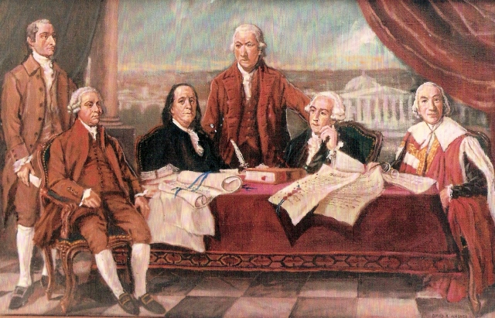
Outcome: ___________________ (1783)
The Revolutionary War ended with…
(Explain any important details.)
The results of ___________ were…
Author’s Last, First Name. “Title." Website Name. Publisher/Organization. Date Published. Web. 00 Sept. 2016.

