Slide 1
The Development of the Atomic Bomb
March 15 and 16

Slide 2
Origins
In 1938, German scientists discovered the power of splitting an atom.
At the urging of several scientists who had fled Europe, a letter was sent to FDR.
The scientists warned that the US had to take action to stop Germany from getting an advantage.

Slide 3
The Manhattan Project
In October 1941 (BEFORE the US entered World War II), FDR approved a nuclear program.
It was kept top-secret and code-named “The Manhattan Project”
Over 120,000 Americans worked on it without knowing exactly what they were doing.

Slide 4
Success
President Truman didn’t know the atomic bomb existed before he took office in April 1945.
He learned that the bomb had been successfully tested in July 1945, at peace talks after V-E Day.

Slide 5
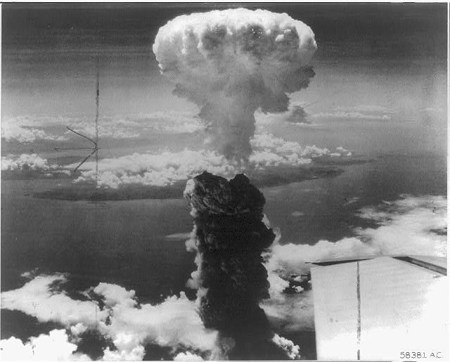
Dropping the bomb
On August 6, 1945 American pilots dropped an atomic bomb on Hiroshima, killing about 70,000 instantly.
Japan still did not surrender and on August 9, 1945, Americans dropped another bomb on Nagasaki.
August 15, 1945 V-J Day.

