Slide 1
Causes of the Civil War

Slide 2
Growing Sectionalism
Sectionalism refers to the growing differences and divide between the North and South prior to the Civil War
The North = URBAN society, people held jobs in industry
The South = AGRICULTURAL society, most people lived on farms and plantations. Heavily reliant on slave labor
Because of their CULTURAL differences, people of the North and South found it difficult to AGREE on social and political issues.

Slide 3
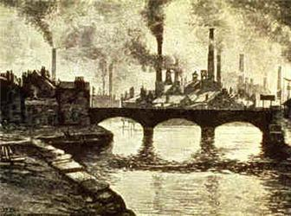
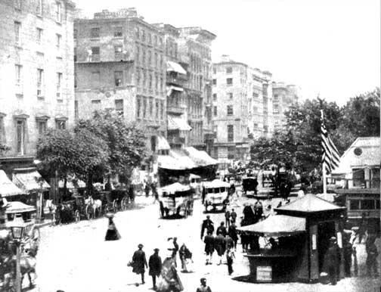
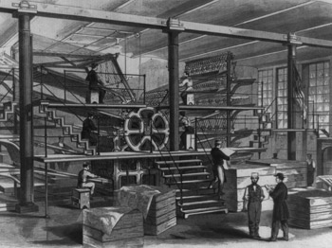
The Urbanized North

Slide 4
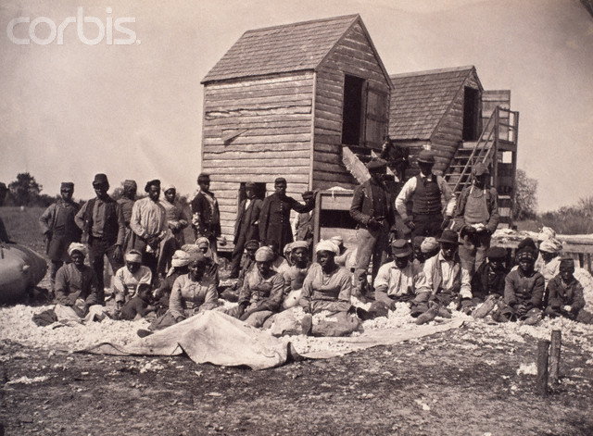
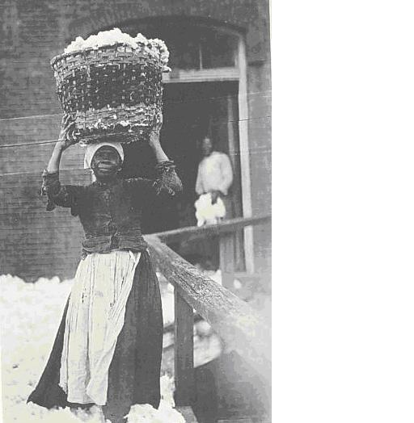
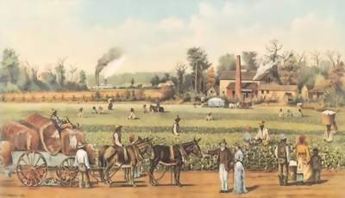
The Agricultural South

Slide 5
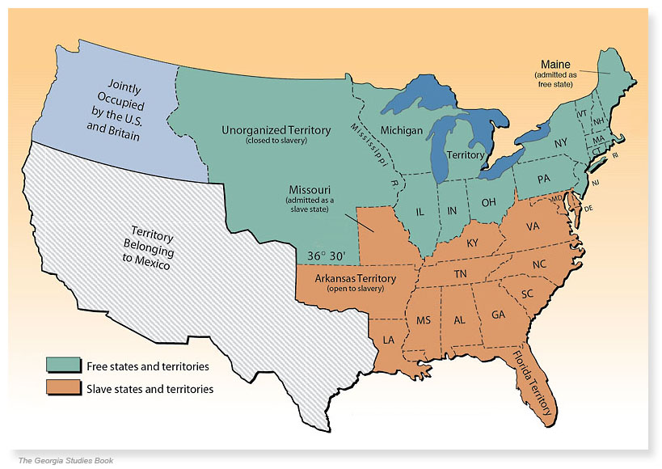
Missouri Compromise-1820
As the US expanded, decisions had to be made over whether or not to allow slavery in the new territories
The compromise prohibited slavery in the Louisiana Territory north of the 36’ 30 line
It allowed slavery south of the line and in Missouri

Slide 6
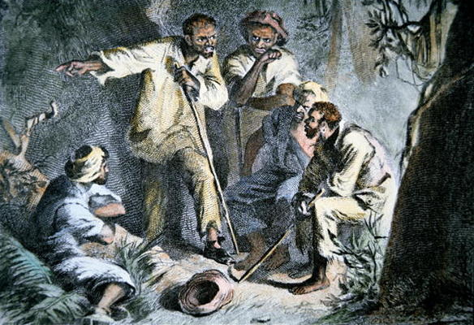
Nat Turner Rebellion -1831
Nat Turner, an enslaved man led 70 enslaved individuals who killed over 60 white slave owners
He was caught and executed
Virginia reacted by restricting slave’s “rights” even further to prevent more uprisings
Limited education
Limited the right to assemble

Slide 7
Compromise of 1850
In 1850 a group of laws were passed in hopes to stop growing sectionalism
California was added as a free state
New Mexico and Utah were granted popular sovereignty, the right to choose for themselves
Slave trade was abolished in DC

Slide 8
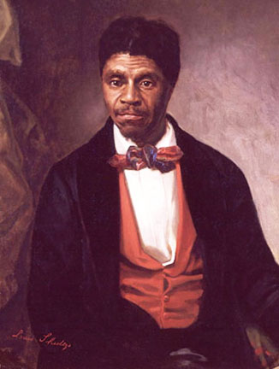
Dred Scott Decision
The Dred Scott case was a key moment in the road to the Civil War
Dred Scott was an enslaved African who had been taken to a free state by his owners
He attempted to sue for his freedom
The Supreme Court decided he was not a citizen and therefore had no right to sue

Slide 9
Stop and Think
These events further divided the country, how did these events lead our nation to the edge of war?

Slide 10
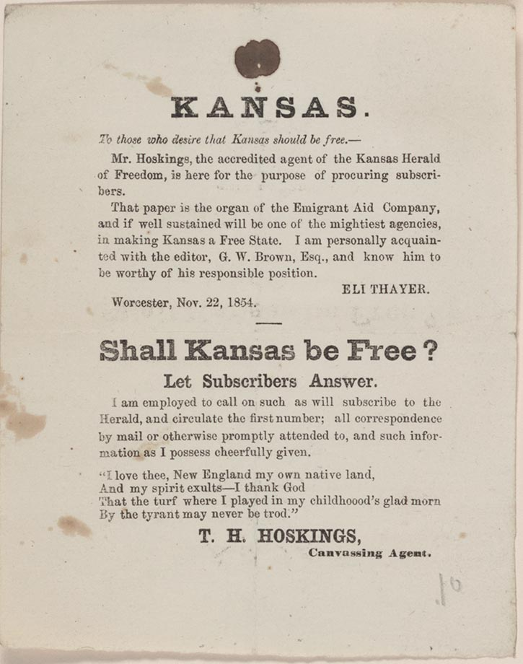
Kansas Nebraska Act
Passed in 1854
Drew new boundaries for Kansas and Nebraska
Left the decision of slavery to popular sovereignty
Pro-slavery and abolitionists settlers rushed to Kansas
Violence erupted and the term “Bleeding Kansas” was coined

Slide 11
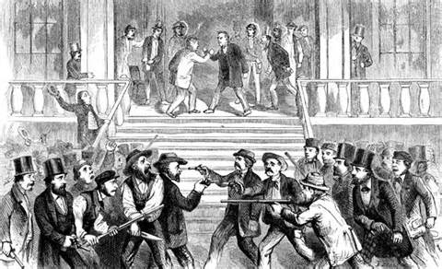

Slide 12
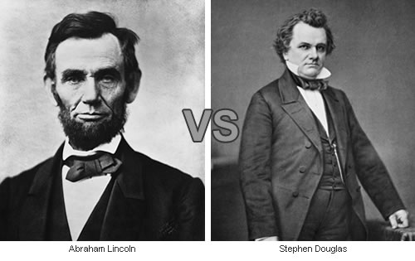
Election of 1860
Tensions in the US had reached a boiling point
The main candidates were Stephen Douglas (pro-slavery) and Abraham Lincoln (opposed to slavery somewhat)

Slide 13
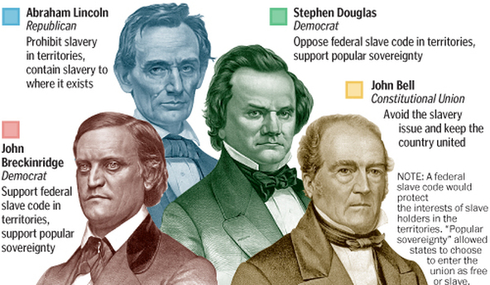

Slide 14
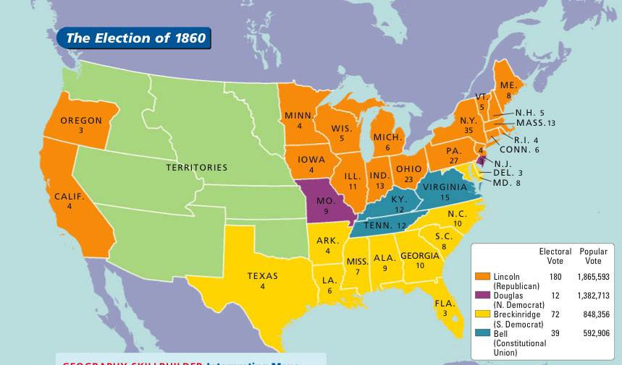

Slide 15
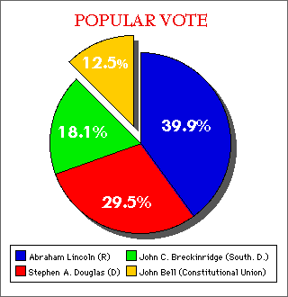

Slide 16
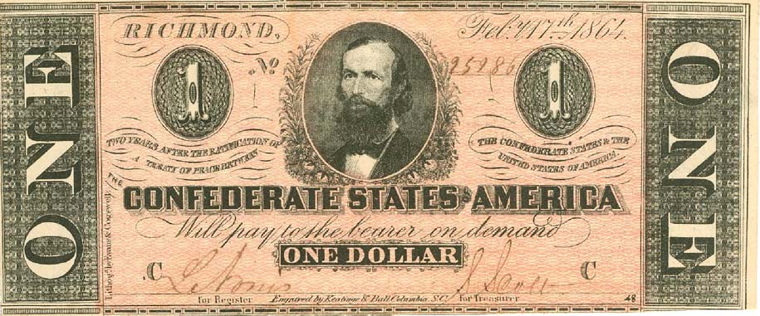
Succession
A few weeks after the election, South Carolina succeed from the Union
Before Lincoln took office, 7 southern states had succeed from the union
They formed the Confederate United States
Now it was up to Lincoln- What was he going to do about it?

Slide 17
The Start of War
http://www.history.com/topics/american-civil-war/american-civil-war-history/videos/us-inches-closer-to-war

Slide 18
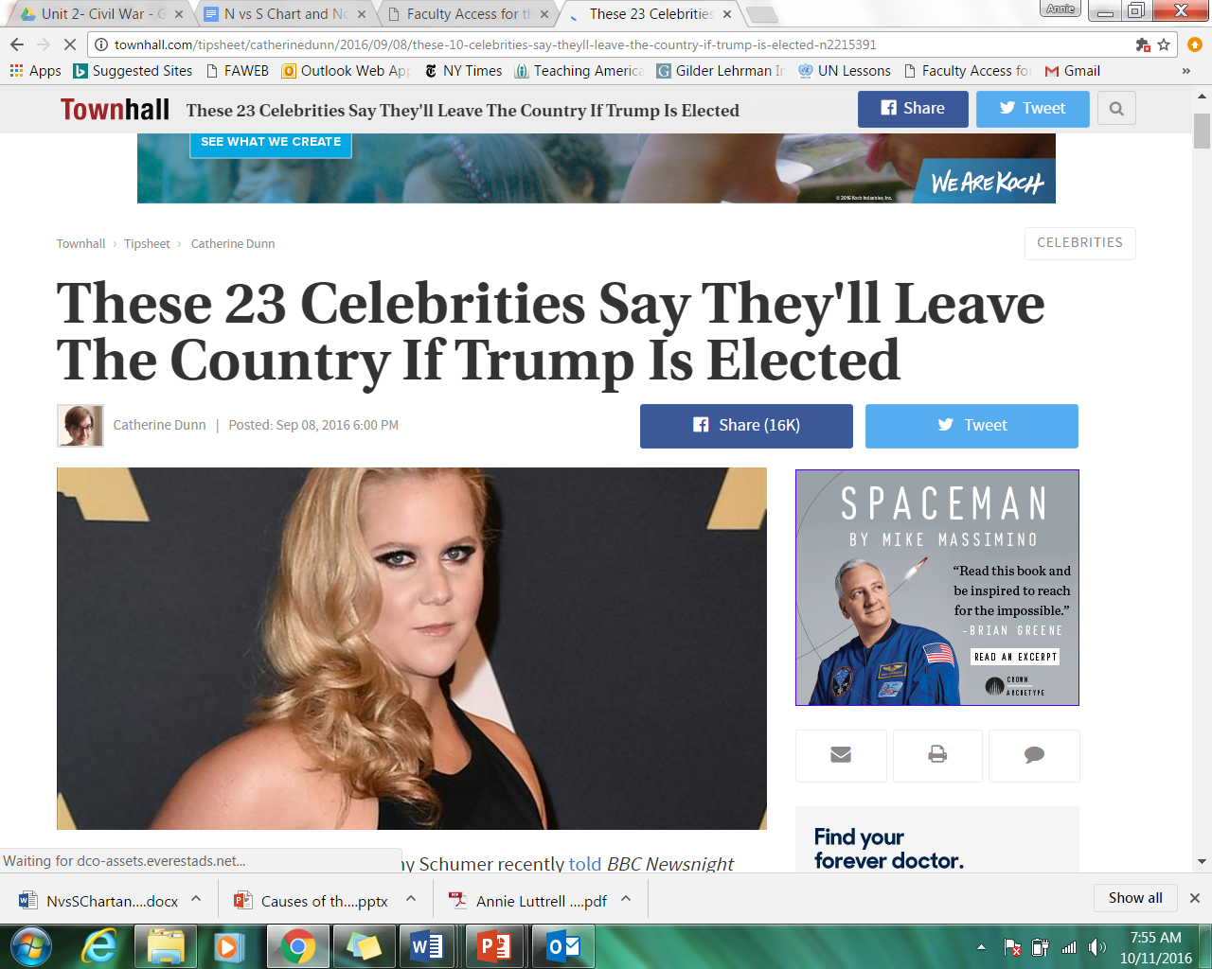

Slide 19
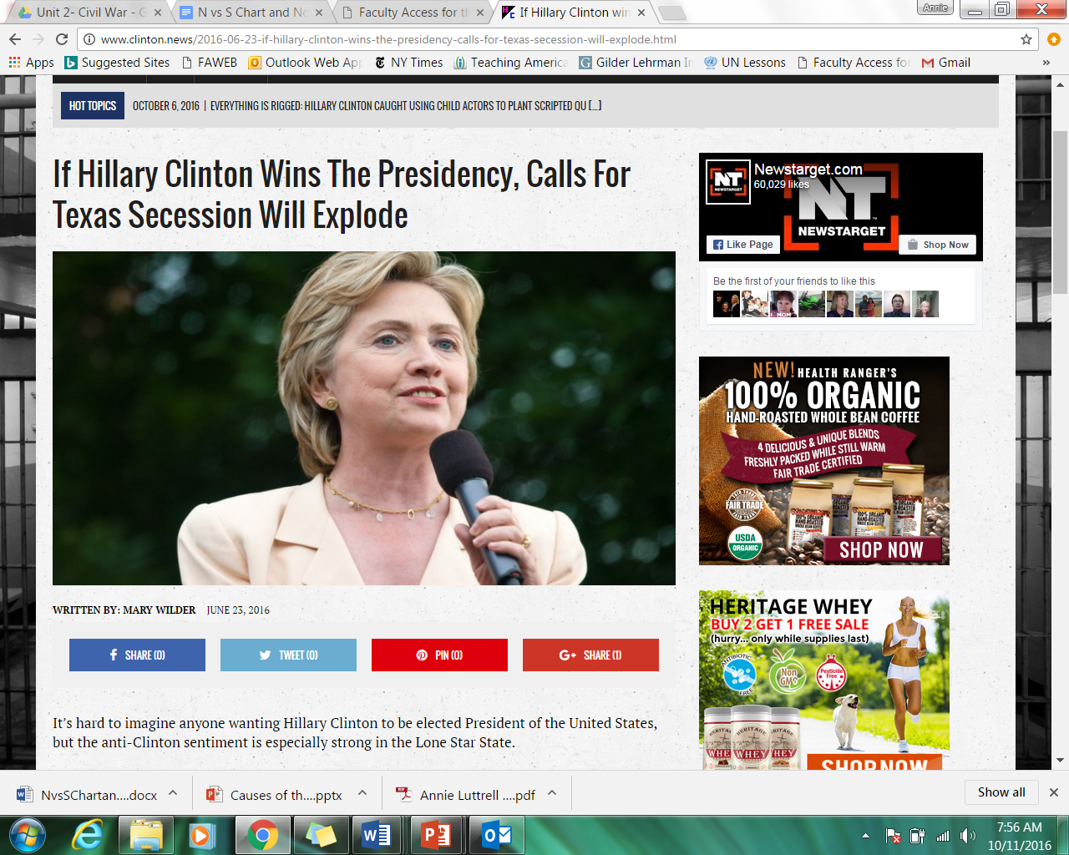
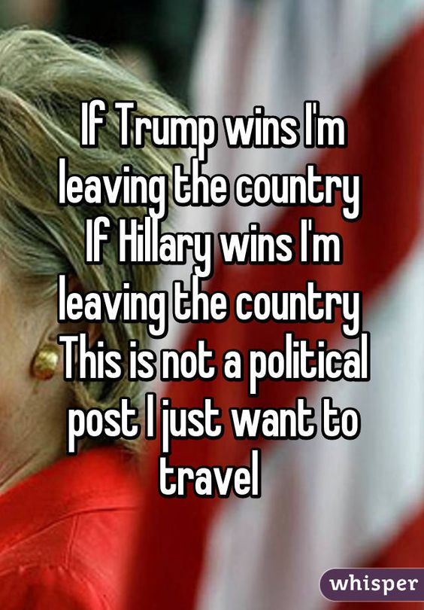

Slide 20
A very wise acquaintance commented to me nearly 2 years ago that she was concerned that the atmosphere in this country had come to resemble the climate of 1860. Since then the polarization of the country has become so extreme that I can no longer dismiss her concern. And the current fractures within both the major political parties further validate her hypothesis.
Lincoln won the presidency but had less than 50% of the total popular vote. The south seceeded and the country experienced the horrific trauma of the Civil War. Slavery was finally abolished, but at a terrible cost. Because of the reaction to the election any less painful method of finally ending that evil institution was lost.
Today we are just as polarized, but not so much geographically as we are by urban vs suburban and rural areas of the country . Functional national government has ceased to exist just as had occurred on the eve of the 1860 election.
And just as in 1860, the major political parties show signs of deep internal fractures and could possibly even split. Much has been written about how the Republican Party faces the risk of division. But a similar risk is increasingly becoming a possibility within the Democratic Party.

