Slide 1
The End of the Civil War
Final Battles and Effects

Slide 2
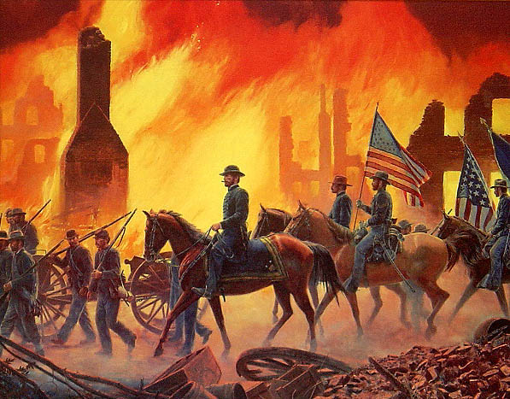
Sherman’s March to the sea
After Gettysburg, Union General Sherman led a March from Atlanta to Savannah
Wanted the people to give up the war
Sherman Said: “not only fighting hostile armies, but a hostile people,” they needed to “make old and young, rich and poor, feel the hard hand of war.”
Stole food and livestock, burned barns and houses of anyone who fought back
Captured Atlanta and destroyed industry there

Slide 3
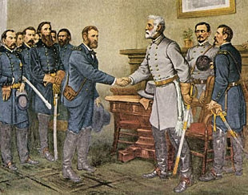
Lee Surrenders
After several more defeats, General Lee was forced to surrender at Appomattox Court House in VA
Lee stated: "After four years of arduous service marked by unsurpassed courage and fortitude the Army of Northern Virginia has been compelled to yield to overwhelming numbers and resources,"
The war had waged on for 4 long years

Slide 4
Lincoln Shot
April 14th Lincoln attended a play at the Ford’s Theater
During the performance an actor, John Wilkes Booth shot Lincoln in the back of the head
He died the next morning
His death served to strengthen the North
He became a hero and symbol of freedom

Slide 5
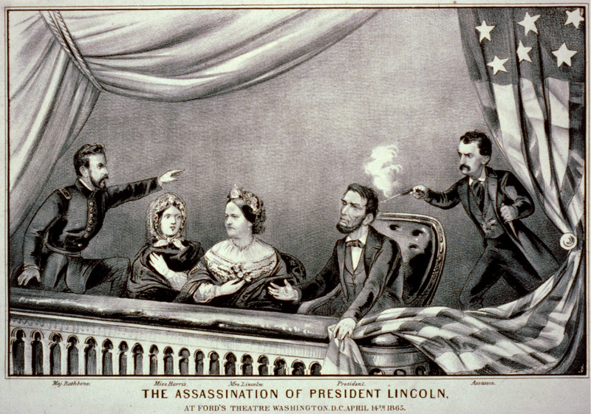
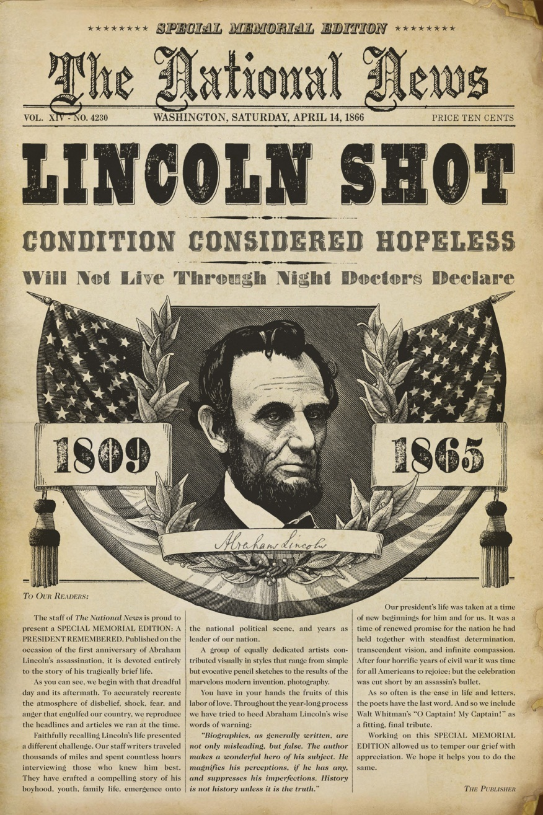
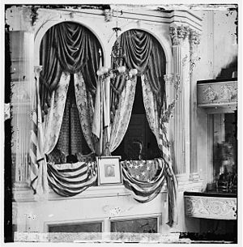

Slide 6
Stop and Think
The war was over, but now what?
What issues was the newly united nation going to deal with?
What consequences of the war would need to be dealt with?

Slide 7
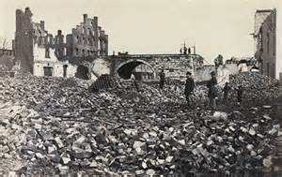
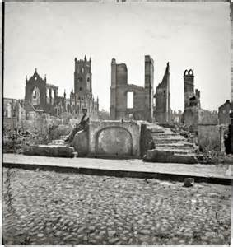
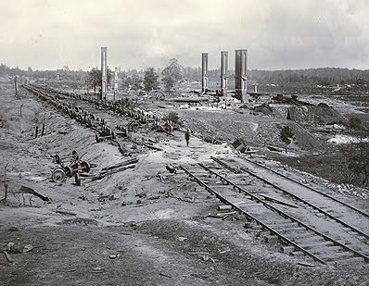
Images of the South After the Civil War

Slide 8
Aftermath
The North lost 364,000 soldiers. The South lost 260,000 soldiers.
Black Southerners were freed and had to start new lives
Plantation owners lost slave labor worth $3 billion.
Poor white Southerners could not find work
The war had destroyed two thirds of the South’s shipping industry
9,000 miles of railroad were destroyed

Slide 9
Reconstruction
The government started a plan to help rebuild the south called Reconstruction
They had to consider 3 major issues
How will southern states rejoin the union?
How will the southern economy be rebuilt?
What rights will African Americans have?

Slide 10
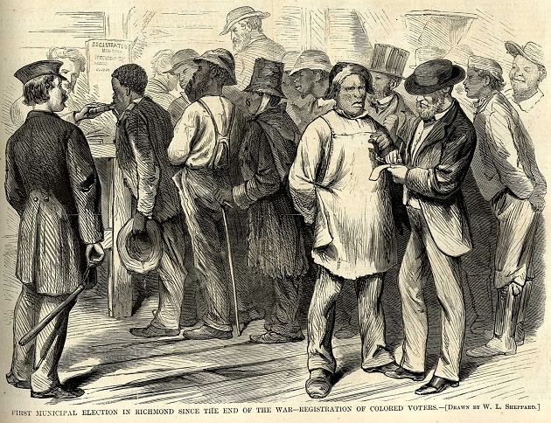
Reconstruction
Plans to rebuild the south became known as Reconstruction
Congress passed laws to protect the rights of African Americans
States who ratified the amendments would be pardoned

Slide 11
13th, 14th, 15th Amendments

Slide 12
Hurdles to reconstruction
Many states passed Black Codes
Laws that sought to keep African Americans as landless workers
African Americans who joined politics faced discrimination and violence
Tensions were high

Slide 13
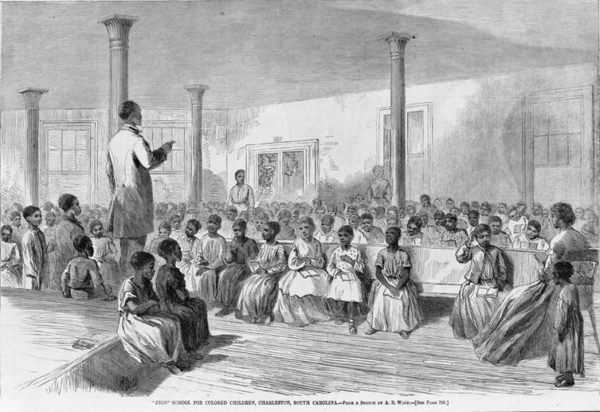
Freedman's Bureau
Established to protect and help African Americans
Tasked with:
Providing former slaves with education
Medical care
Overseeing labor contracts
Reuniting separated families
Establishing jobs

Slide 14
40 acres and a mule
The Freedmen’s Bureau encouraged most freedmen to work on plantations
They also came up with the strategy “40 acres and a mule”
In the end only 1% actually received the land they had been promised.

