Slide 1
The Progressive Era

Slide 2
Progressive Era Definition- A Time of Massive Reform to cure the ills of the Industrial Age, 1890-1920
A new type of journalism called Muckraking became popular
Its goal was to expose issues and injustices occurring

Slide 3
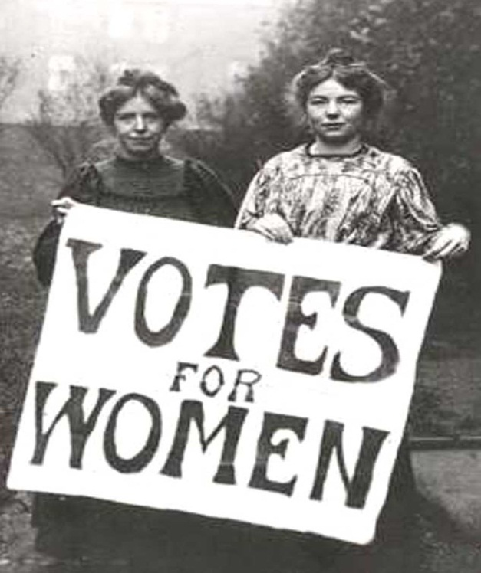
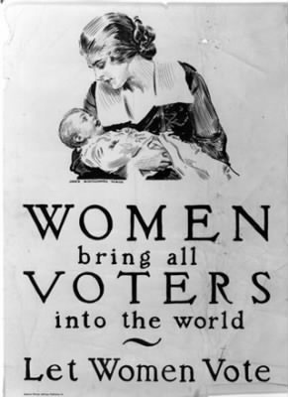
Women’s Suffrage
Problem
Reform
Women were not allowed to vote
Susan B Anthony, Elizabeth Cady Stanton and others campaigned for equal rights
19th Amendment gave all women the right to vote

Slide 4
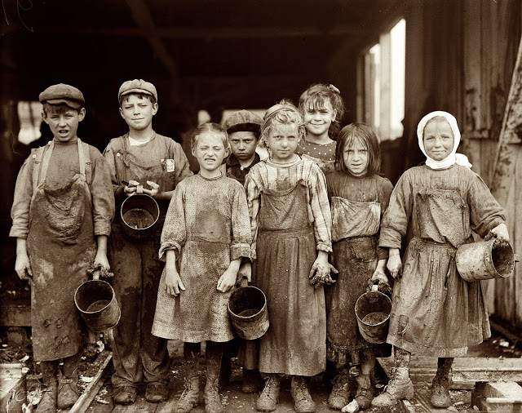
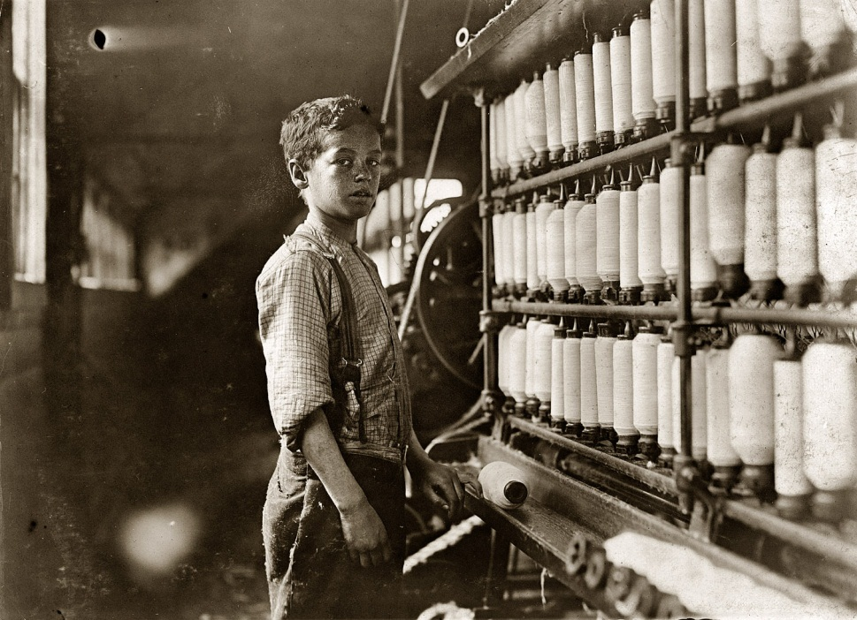
Child Labor
Problem
Reform
Long Hours
Unsafe Machines
Unsanitary Conditions
Lewis Hine published images of children in factories
Legal Working Age (12-16)
Work Day Hours Limited
Workers Compensation Instated

Slide 5
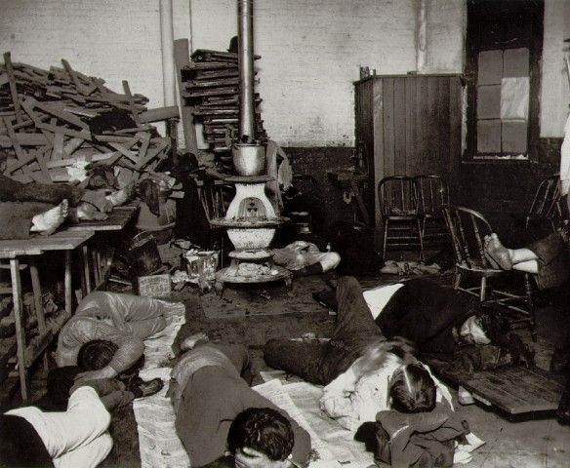
Housing
Problem
Reform
Unsafe conditions
Cramped Buildings
Fires
Jacob Riis exposed conditions with book “How the Other Half Lives”
NYC passed building codes

Slide 6
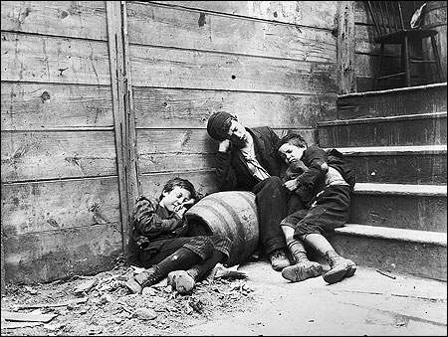
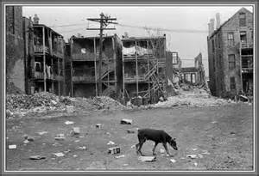
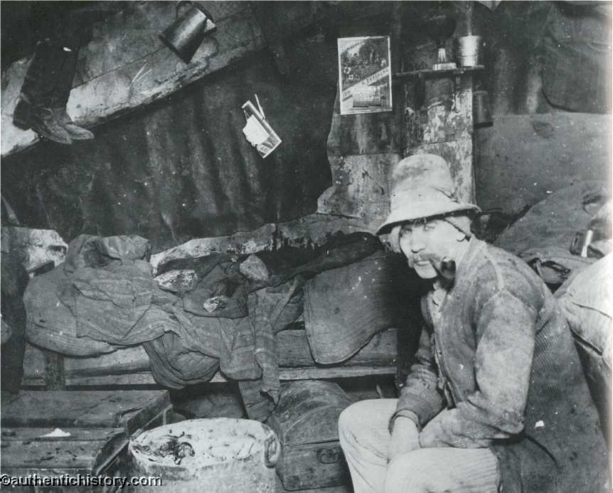
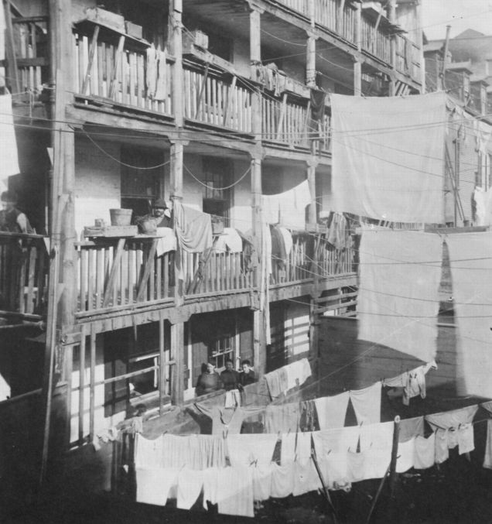

Slide 7
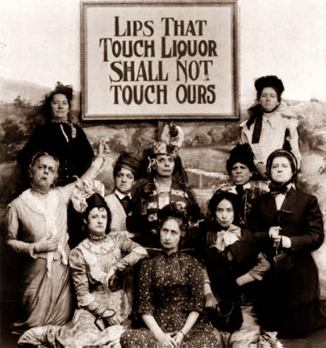
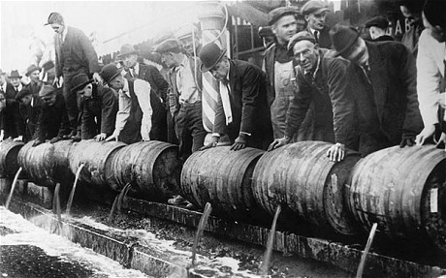
Temperance/Prohibition
Problem
Drunkenness was a growing concern
Led to health problems and poverty
Reform
18th Amendment prohibited the making, selling, and purchasing of alcohol

Slide 8
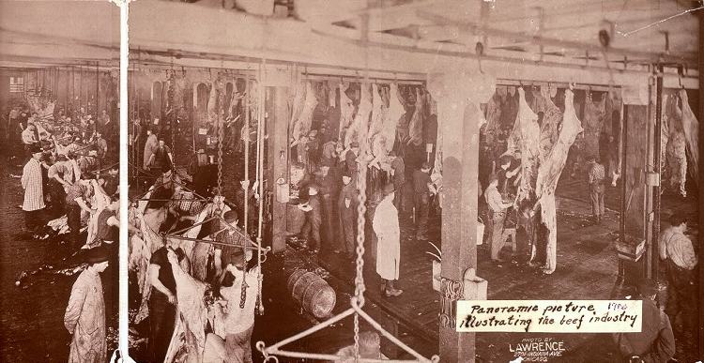
Food Safety
Problem
Reform
Unsanitary conditions in meat industry
Upton Sinclair’s The Jungle exposed horrors
Meat Inspection Act was Passed
1906 Food and Drug Act

Slide 9
African American Rights
Problem
Reform
Racism lingered
Unequal Job Opportunities
W.E.B Du Bois founder of NAACP
Booker T Washington encouraged education
Founding of NAACP
National Urban League Founded
Both sought to improve economic opportunities for African Americans and promote equality

Slide 10
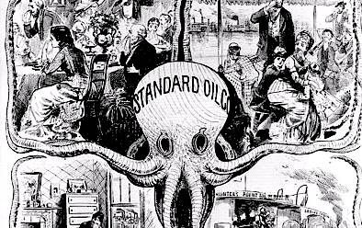
Big Business
Problem
Reform
Many business were monopolies, they dominated an entire industry
This led to unfair business practices
Ida Tarbell exposed practices of Standard Oil
Anti-Trust and Anti-Monopoly laws passed

