Slide 1
World War II: Europe and the Pacific
March 10 and 13, 2017

Slide 3
D Day: Operation Overlord

Slide 4
D Day’s Effects
Surprise attack by the Allies on the Germans in Normandy, France.
156,000 troops stormed the beach on June 6, 1944, and Allies suffered about 10,000 casualties (wounded, missing, and dead).
This was the beginning of an Allied movement across Europe, pushing the Germans back to Berlin.
At the same time, Russian troops were pushing west.

Slide 6
The Fall of Nazi Germany
The Soviet Union soldiers began a siege of Berlin in January 1945.
Hitler began to live in a bunker under the city.
On April 12, 1945 FDR dies, and Harry Truman becomes president.
As the enemy approached, Hitler committed suicide on April 30, 1945.
The Germans signed an unconditional surrender to begin on May 8, 1945, V-E Day.

Slide 7
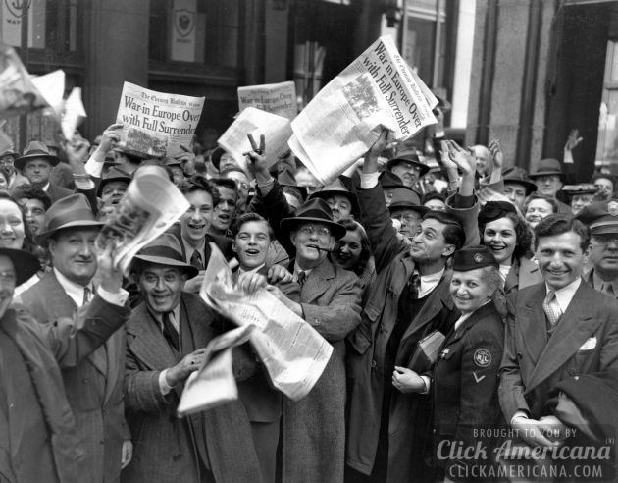

Slide 8
The War in the Pacific
Although Germany surrendered, the US was still fighting hard in Japan.
The strategy used was called “leapfrogging,” moving from one island to another, closer to Japan.
Although the US was making progress, conditions were brutal.

