Slide 1
Foreign Policy: Then and Now
March 6 and 7, 2017

Slide 2
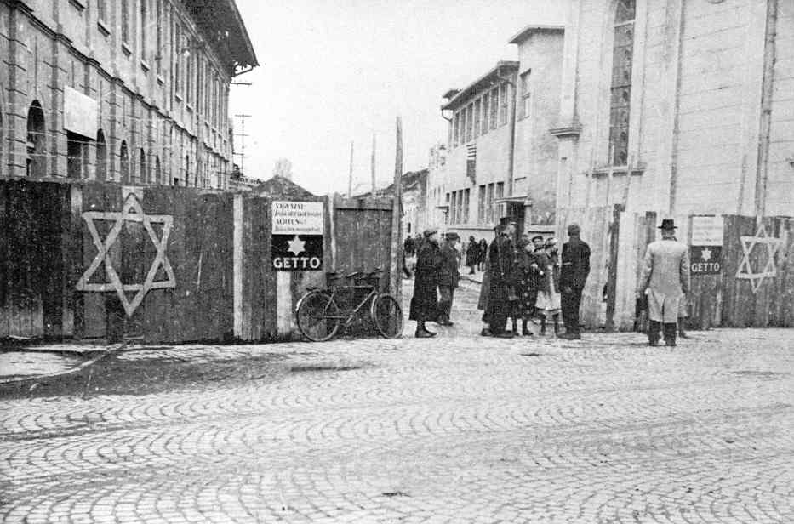
What were the Nazis doing in Europe?
Hitler and the Axis powers controlled much of Europe, and placed more and more restrictions on Jews.
Ghettos were created in European cities, and Jews were forced to live there.

Slide 3
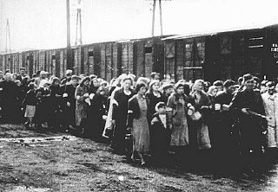
Nazi strategy
Ghettos were a way for Nazis to control Jews, and from there, they deported them to concentration camps.
Although there were many concentration camps, news of them was kept secret from the Allies.

Slide 4
Concentration camps

Slide 5
What was the refugee policy in the US?
1924 Immigration Act placed an immigration “quota” on immigrants from different countries.
In the late 1930s, it was around 35,000 for Germany and Austria.
Strict standards also meant the quota wasn’t met until Roosevelt pressured State Department.
Americans feared that refugees were spies.

Slide 6
What did the US know about the Holocaust?
The US government didn’t know about “Jewish extermination” until late 1942.
Even then, US did not know quite how brutal concentration camps were.
Once the US learned about Nazi actions, there was no agreement in foreign policy.

Slide 7
What did the US do?
In January 1944, FDR finally created the War Refugee Board:
“to take all measures within its power to rescue the victims of enemy oppression who are in imminent danger of death.”
Estimated to have saved about 200,000 lives.
Around 6 million Jews died in the Holocaust.

