Slide 1
The Beginnings of World War II

Slide 2
Great Britain
I would rather give someone what he wants than start a fight.

Slide 3
United States
I try to stay out of my friends’ arguments.

Slide 4
Germany
If I’m told what I can’t do, I like to push the boundaries.

Slide 5
France
People should be punished for their actions.

Slide 6
Poland
I expect my friends to support me if I get into a fight.

Slide 7
Appeasement
After WWI, many European countries were tired of fighting.
Great Britain and France wanted to give in to Germany’s actions rather than start another conflict.
Appeasement is NOT a long-term solution.

Slide 8
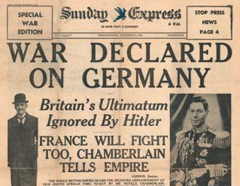
Start of World War II
Great Britain and France had signed a Common Defense Pact with Poland, so that they had to defend Poland if it was attacked.
On September 1, 1939, Germany marched into Poland, and Great Britain and France declared war.

Slide 9
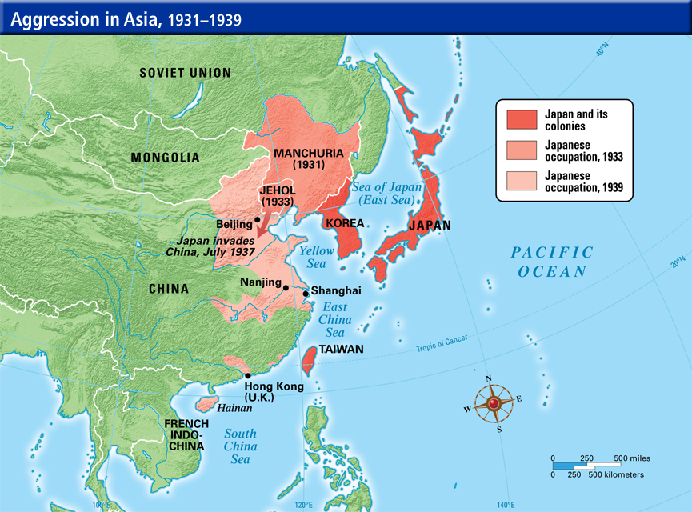
Japanese actions in Asia and the Pacific

Slide 10
Who was fighting?
Allied Powers
Great Britain
France
Poland
Axis Powers
Germany
Japan
Italy

Slide 11
Initial Progress of War
Germany swept through Europe quickly, taking control of many countries throughout Europe.
The USSR signed a non-aggression pact with Germany and invaded Poland from the east.

Slide 12
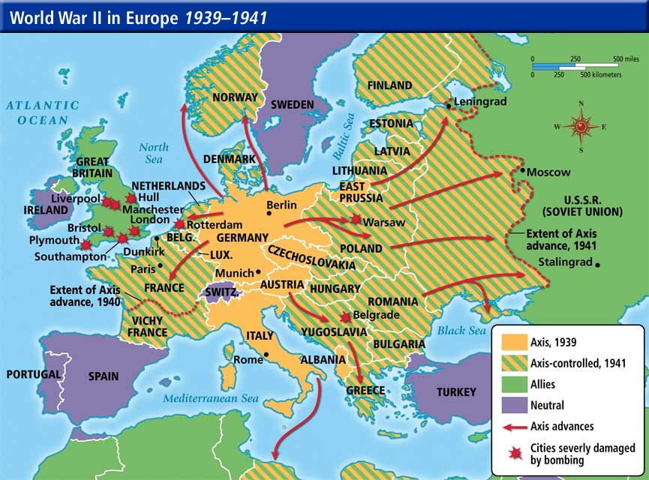

Slide 13
The United States’ involvement
The United States passed Neutrality Acts in the 1930s.
The US allowed Britain to move from “cash and carry” to “lend-lease.”
“Cash and carry” was the US selling non-military supplies to other countries.
Lend-lease allowed countries at war to buy military supplies and not pay. Instead, US leased military bases in their country.

Slide 14
Pearl Harbor
On the morning of December 7, 1941, Japan surprised the United States with an attack on Pearl Harbor.
The attack was supposed to destroy the Pacific fleet, making it impossible for the US to fight back.
2,335 men were killed and 1,143 were wounded.
8 battleships were damaged and over 300 airplanes were destroyed.
The United States declared war the next day, with one dissenting vote.

